Slide 1



Memory Systems Fundamentals, Recent Research, Challenges, Opportunities Lecture 1a: Memory Importance and Trends
Prof. Onur Mutlu
omutlu@gmail.com
https://people.inf.ethz.ch/omutlu
8 October 2018
Technion Fast Course 2018

Slide 2
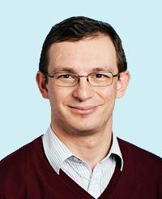
Brief Self Introduction
Onur Mutlu
Full Professor @ ETH Zurich CS (EE), since September 2015
Strecker Professor @ Carnegie Mellon University ECE (CS), 2009-2016, 2016-…
PhD from UT-Austin, worked at Google, VMware, Microsoft Research, Intel, AMD
https://people.inf.ethz.ch/omutlu/
omutlu@gmail.com (Best way to reach me)
https://people.inf.ethz.ch/omutlu/projects.htm
Research and Teaching in:
Computer architecture, hardware security, bioinformatics, computing platforms
Memory and storage systems
Hardware security, safety, predictability
Fault tolerance
Hardware/software cooperation
Architectures for bioinformatics, health, medicine
…

Slide 3
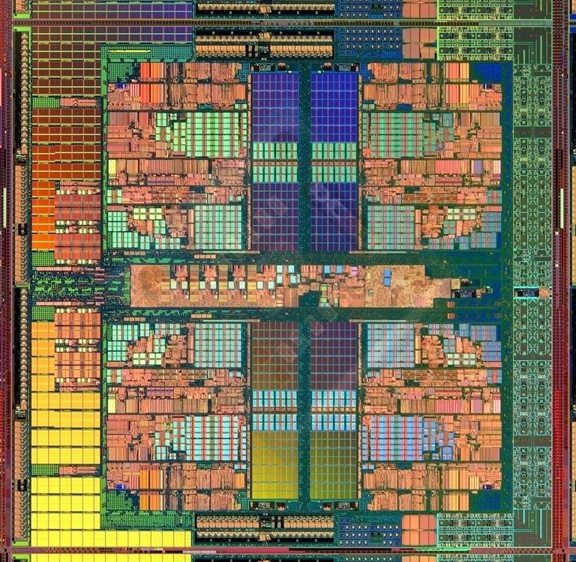
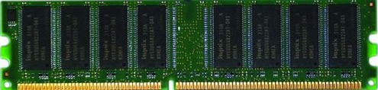
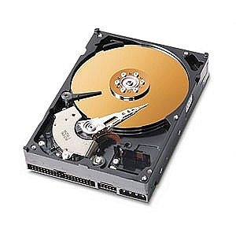
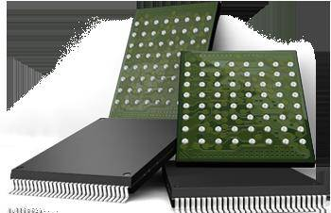
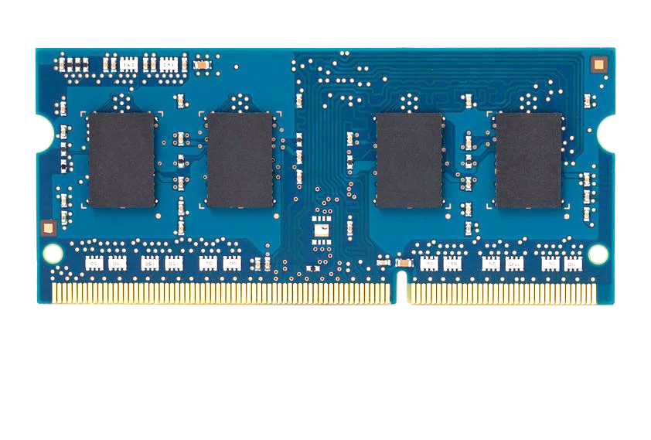
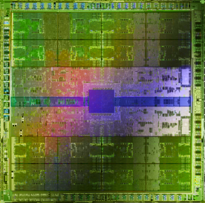
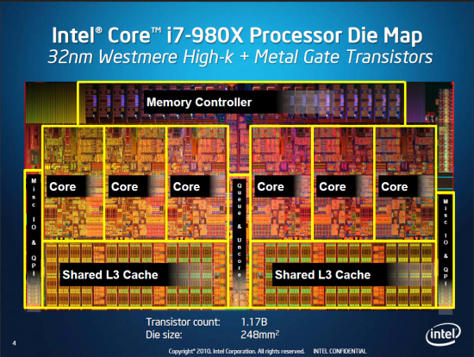
Current Research Focus Areas
Research Focus: Computer architecture, HW/SW, bioinformatics, security
Memory and storage (DRAM, flash, emerging), interconnects
Heterogeneous & parallel systems, GPUs, systems for data analytics
System/architecture interaction, new execution models, new interfaces
Hardware security, energy efficiency, fault tolerance, performance
Genome sequence analysis & assembly algorithms and architectures
Biologically inspired systems & system design for bio/medicine
Hybrid Main Memory
Heterogeneous
Processors and
Accelerators
Persistent Memory/Storage
Broad research
spanning apps, systems, logic
with architecture at the center
Graphics and Vision Processing
Notes:
Professor Mutlu’s research focus is all aspects of computer architecture, HW/SW interaction and bioinformatics.
He is looking for students to perform research in these areas.
He and his group, SAFARI, solve fundamental problems spanning:
Memory, memory, memory, storage, interconnects
Parallel architectures, heterogeneous architectures, GP-GPUs
System/architecture interaction, new execution models
Energy efficiency, fault tolerance, hardware security
Genome sequence analysis and assembly
His group does broad research spanning systems to logic with architecture at center

Slide 4
Four Key Directions
Fundamentally Secure/Reliable/Safe Architectures
Fundamentally Energy-Efficient Architectures
Memory-centric (Data-centric) Architectures
Fundamentally Low-Latency Architectures
Architectures for Genomics, Medicine, Health

Slide 5
A Motivating Detour: Genome Sequence Analysis

Slide 6
Our Dream
An embedded device that can perform comprehensive genome analysis in real time (within a minute)
Which of these DNAs does this DNA segment match with?
What is the likely genetic disposition of this patient to this drug?
. . .

Slide 7
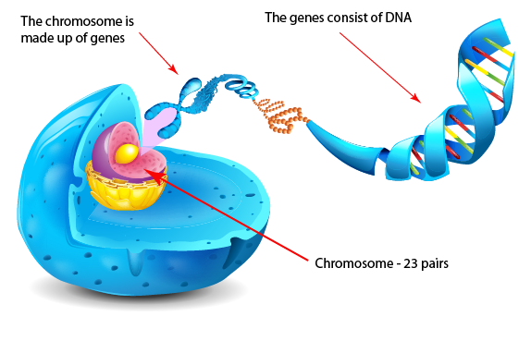
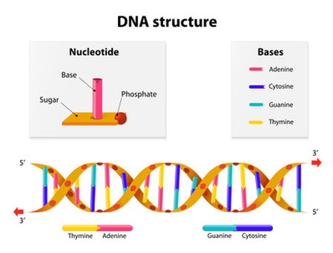
What Is a Genome Made Of?
Cell
Nucleus
The discovery of DNA’s double-helical structure (Watson+, 1953)
Notes:
Unlocking the life’s code requires diving into the nucleus of our body cells, where the double-stranded genome resides. Genome is literally the 'code of life' - it is the set of instructions for making everything from you to zebras, strawberries, and even yeast.
since the discovery of dna’s double-helical structure (watson et al. 1953)

Slide 8
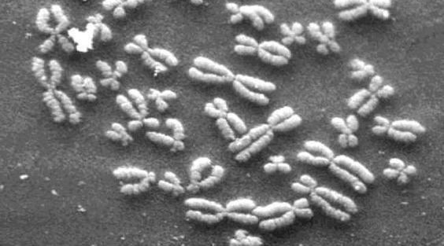
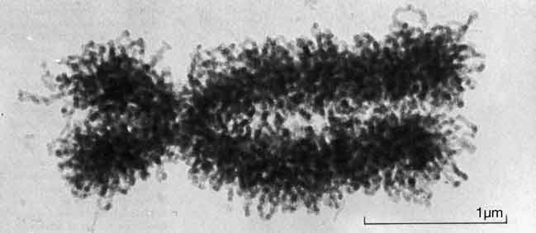
DNA Under Electron Microscope
human chromosome #12
from HeLa’s cell
Notes:
Henrietta Lacks,

Slide 9
DNA Sequencing
Goal:
Find the complete sequence of A, C, G, T’s in DNA.
Challenge:
There is no machine that takes long DNA as an input, and gives the complete sequence as output
All sequencing machines chop DNA into pieces and identify relatively small pieces (but not how they fit together)

Slide 10
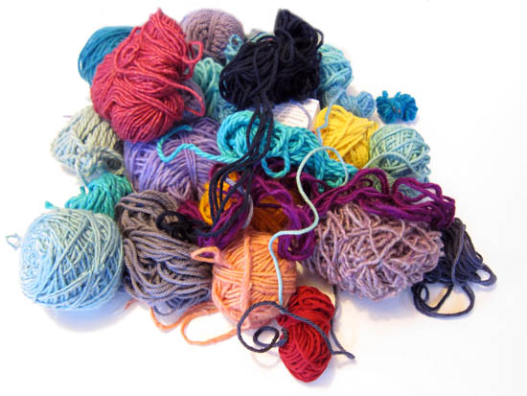
Untangling Yarn Balls & DNA Sequencing
Notes:
untangling yarn ball

Slide 11
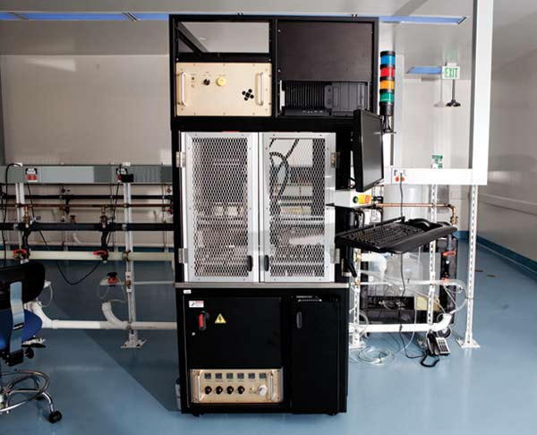
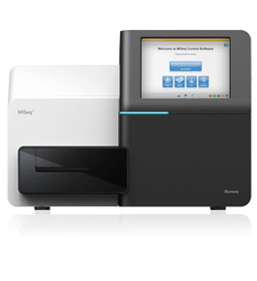
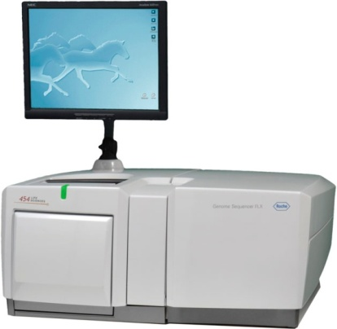
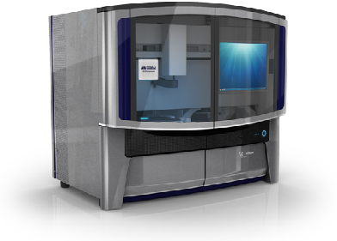
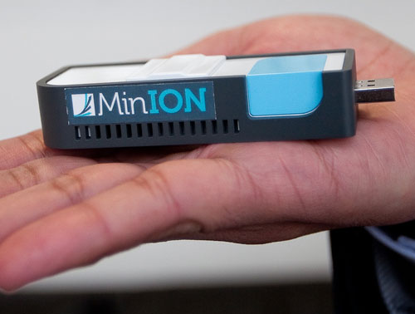
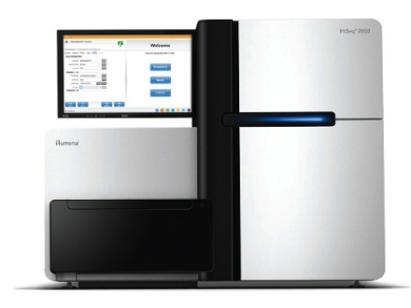
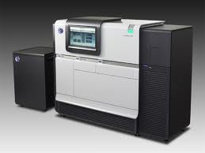
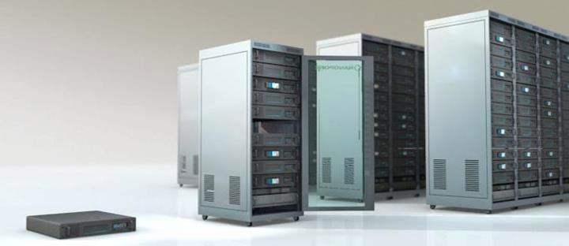
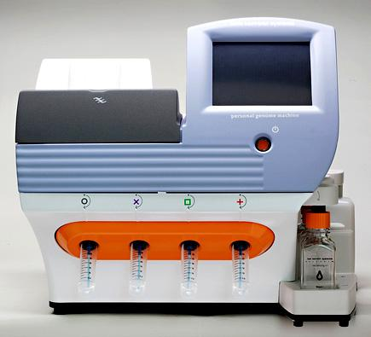
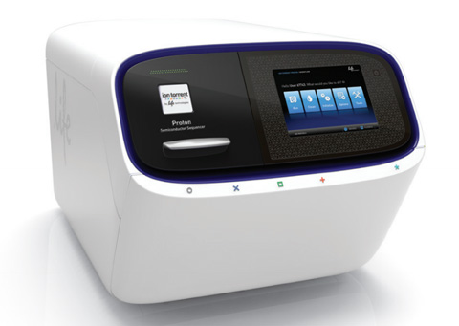
Genome Sequencers
Illumina MiSeq
Complete
Genomics
Roche/454
AB SOLiD
Oxford Nanopore MinION
Illumina
NovaSeq
6000
Illumina HiSeq2000
Pacific Biosciences RS
Oxford Nanopore GridION
Ion Torrent PGM
… and more! All produce data with different properties.
Ion Torrent Proton

Slide 12

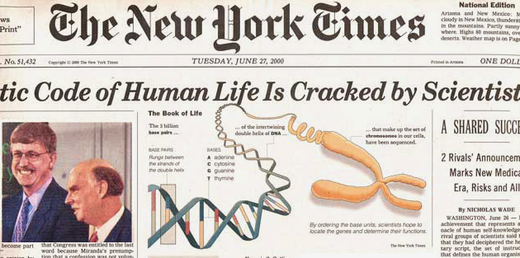

The Genomic Era
1990-2003: The Human Genome Project (HGP) provides a complete and accurate sequence of all DNA base pairs that make up the human genome and finds 20,000 to 25,000 human genes.
13 year-long
$3,000,000,000
Notes:
The 13-year long human project is the starting of the genomic era! It opened the door to remarkable biomedical discoveries by providing the first complete human genome sequence. It cost 3 billion dollars to read the entire sequence.

Slide 13
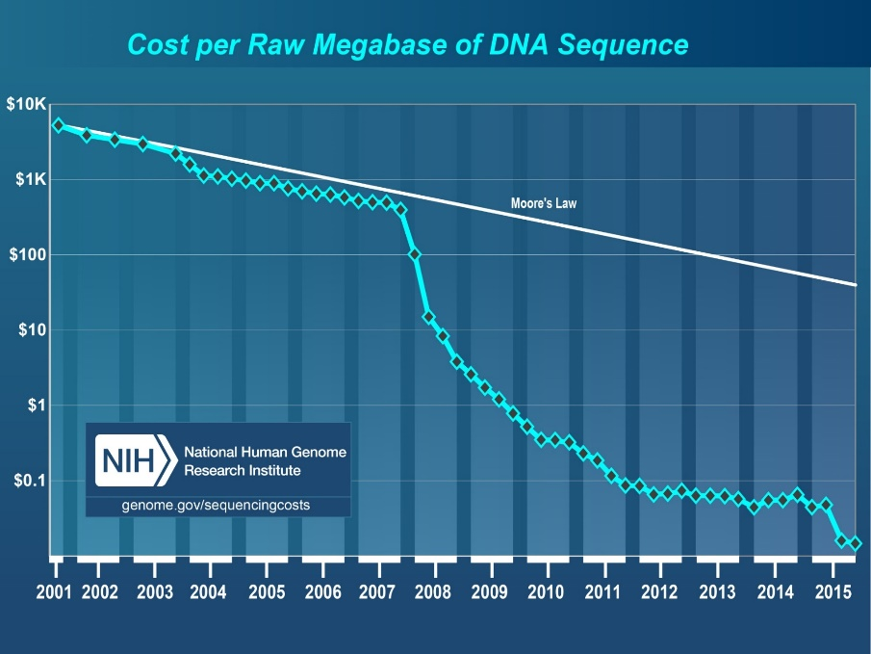
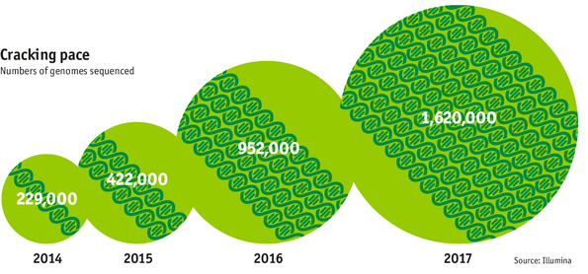

The Genomic Era (continued)
development of high-throughput sequencing (HTS) technologies
Number of Genomes Sequenced
http://www.economist.com/news/21631808-so-much-genetic-data-so-many-uses-genes-unzipped
Notes:
However, since the development of high throughput sequencing (HTS) technologies, the cost of genome sequencing has fallen off a cliff (<< 1,000$) making it viable for almost everyone's use.

Slide 14
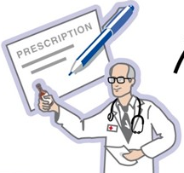
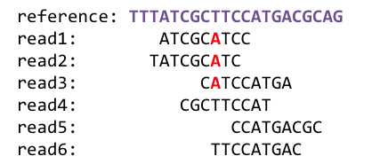
1
Sequencing
Genome Analysis
Read Mapping
2
Variant Calling
Scientific Discovery
3
4
Notes:
Genome analysis starts with sequencing random short DNA fragments of copies of the original molecule.
Unfortunately, these reads lack information about their order and which part of genome they are originated from.
Hence the second step is to map these reads to a long reference genome.

Slide 15
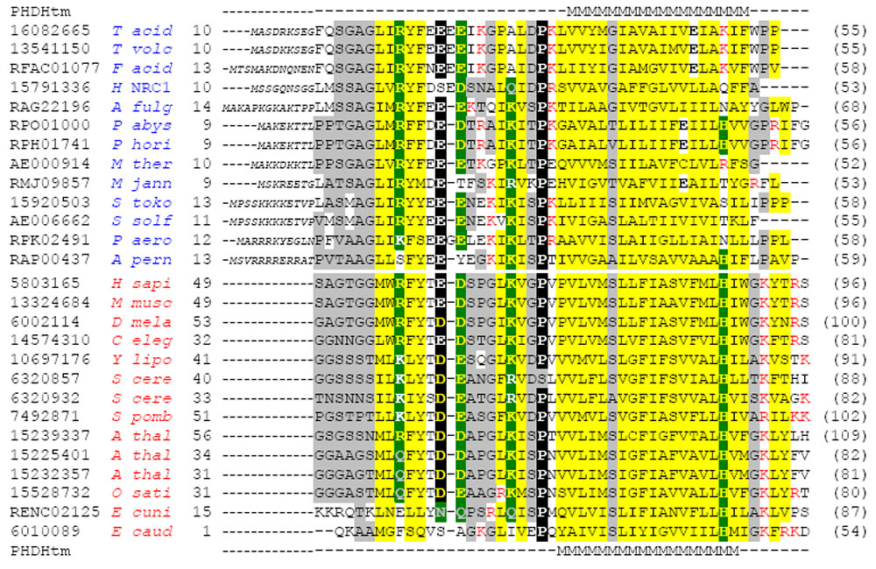
Multiple sequence alignment
Example Question: If I give you a bunch of sequences, tell me where they are the same and where they are different.

Slide 16
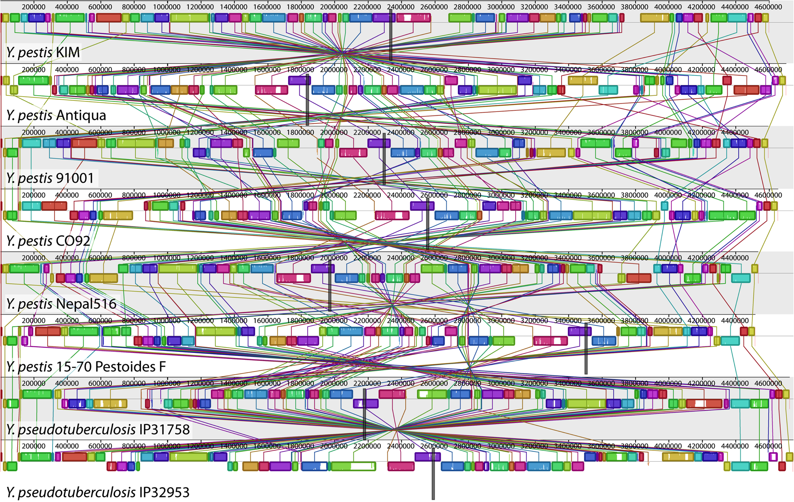
Genome Sequence Alignment: Example
Source: By Aaron E. Darling, István Miklós, Mark A. Ragan - Figure 1 from Darling AE, Miklós I, Ragan MA (2008).
"Dynamics of Genome Rearrangement in Bacterial Populations". PLOS Genetics. DOI:10.1371/journal.pgen.1000128., CC BY 2.5, https://commons.wikimedia.org/w/index.php?curid=30550950

Slide 17



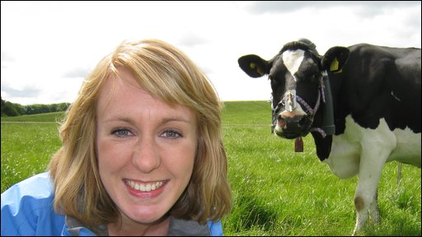

The Genetic Similarity Between Species
Human ~ Chimpanzee
96%
Human ~ Cat
90%
Human ~ Human
Human ~ Cow
99.9%
80%
Human ~ Banana
50-60%

Slide 18
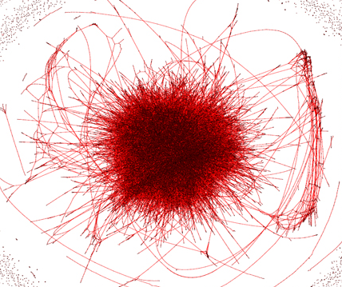
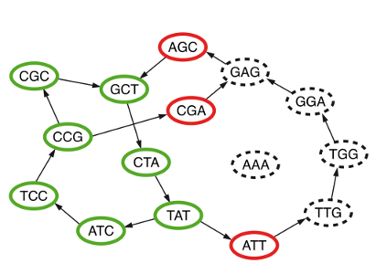
Metagenomics, genome assembly, de novo sequencing
Question 2: Given a bunch of short sequences, Can you identify the approximate species cluster for genomically unknown organisms (bacteria)?
uncleaned de Bruijn graph
http://math.oregonstate.edu/~koslickd
Notes:
organism detection in metagenomes

Slide 19
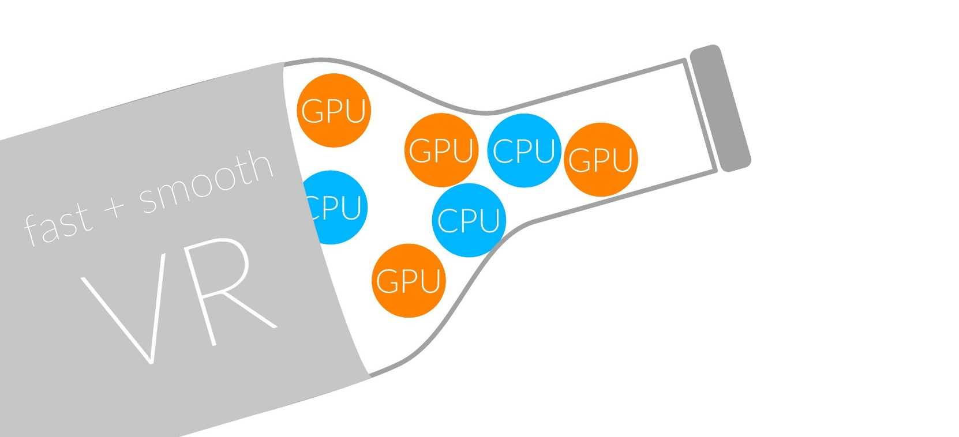
1
Sequencing
Read Mapping
2
Bottlenecked in Mapping!!
Illumina HiSeq4000
on average
GAGTCAGAATTTGAC
2 M
bases/min
300 M
bases/min
GAGTCAGAATTTGAC
GAGTCAGAATTTGAC
GAGTCAGAATTTGAC
GAGTCAGAATTTGAC
GAGTCAGAATTTGAC
GAGTCAGAATTTGAC
GAGTCAGAATTTGAC
GAGTCAGAATTTGAC
GAGTCAGAATTTGAC
GAGTCAGAATTTGAC
GAGTCAGAATTTGAC
GAGTCAGAATTTGAC
GAGTCAGAATTTGAC
GAGTCAGAATTTGAC
(0.6%)
Variant Calling
Scientific Discovery
3
4
Notes:
Typical sequencer machine generates a flood of reads, for example, Illumina HiSeq4000 generates 300 million bases/minute.
However, existing computer alignment algorithms can only process 0.6% of these reads in the same amount of time.
This gap is widening as more advanced sequencers are made available in the market.

Slide 20
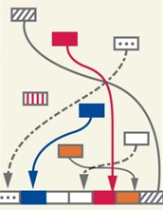
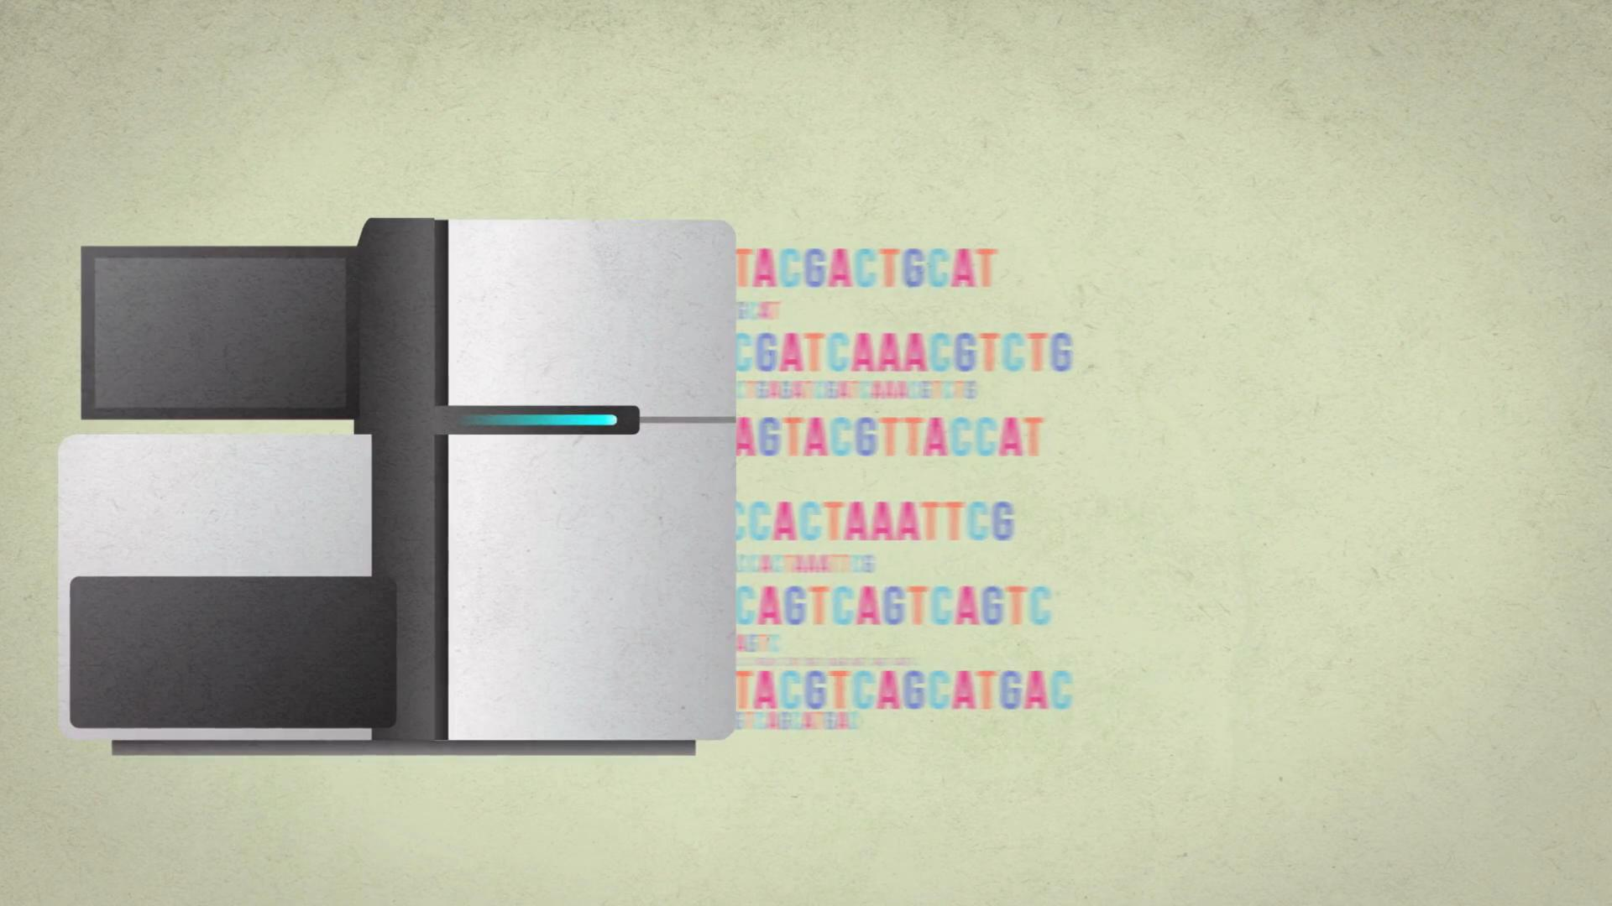

The Read Mapping Bottleneck
ACGTACGTACGTACGT
CCCCCCTATATATACGTACTAGTACGT
ACGACTTTAGTACGTACGT
TATATATACGTACTAGTACGT
ACGTACGCCCCTACGTA
TATATATACGTACTAGTACGT
ACGACTTTAGTACGTACGT
TATATATACGTACTAAAGTACGT
TATATATACGTACTAGTACGT
ACGTTTTTAAAACGTA
TATATATACGTACTAGTACGT
ACGACGGGGAGTACGTACGT
TATATATACGTACTAAAGTACGT
Illumina HiSeq4000
300
Million
bases/minute
2
Million
bases/minute
150X slower

Slide 21
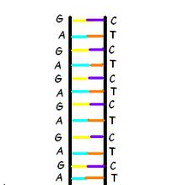
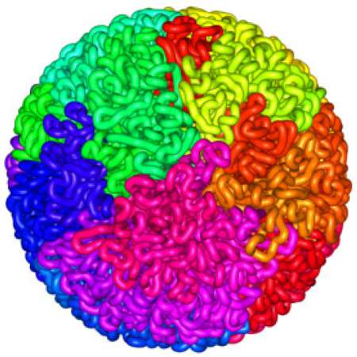
Read Mapping
Map many short DNA fragments (reads) to a known reference genome with some minor differences allowed
Reference genome
Reads
DNA, physically
DNA, logically
Mapping short reads to reference genome is challenging (billions of 50-300 base pair reads)
Notes:
Read mapping is a post processing procedure after DNA sequencing. It maps the data output from a DNA sequencer, which are many short DNA fragments, to a known reference genome, with some minor differences allowed.
To illustrate the problem better, let us take a closer look at the DNA itself. Logically, the DNA is a double stranded long string. In reality, within a cell they folded into a sphere in the nucleus like a ball of wool. Since it is very hard to disentangle the DNA at molecular level, to extract the information out, a sequencer cuts the mass into many short DNA pieces which are called reads.
A mapper’s job is to find where these DNA short reads are most likely to be originally placed so that later we can assemble them in the correct order to restore the original DNA.
Mapping these short reads, up to billions of them, with each one being 50 to 300 base-pairs long, to the reference genome is challenging.

Slide 22
Challenges in Read Mapping
Need to find many mappings of each read
A short read may map to many locations, especially with High-Throughput DNA Sequencing technologies
How can we find all mappings efficiently?
Need to tolerate small variances/errors in each read
Each individual is different: Subject’s DNA may slightly differ from the reference (Mismatches, insertions, deletions)
How can we efficiently map each read with up to e errors present?
Need to map each read very fast (i.e., performance is important)
Human DNA is 3.2 billion base pairs long → Millions to billions of reads (State-of-the-art mappers take weeks to map a human’s DNA)
How can we design a much higher performance read mapper?
Notes:
There are three main challenges.
First. The mapper needs to find many mappings for each read. Because the read is so short, they can map to multiple locations in the reference genome. How can we efficiently find all mappings of a read?
Second. The mapper needs to tolerate small variance or errors in each read. Since individuals are different, the subject’s DNA might slightly differs from the reference DNA, which can be mismatches, insertions or deletions of base pairs. How can we efficiently map each read with up to a number of e errors present?
Third. The mapper needs to map each read very fast. In another word, performance is important. Because the human DNA is 3.2 billion base-pairs long and each read is only hundreds of base-pairs long, there can be billions of reads subjected to mapping for an individual human. Current state of the art mappers take weeks to map a human’s DNA. So the question is, how can we design a much higher performance read mapper?

Slide 23
Our First Step: Comprehensive Mapping
+ Guaranteed to find all mappings → sensitive
+ Can tolerate up to e errors
http://mrfast.sourceforge.net/
Alkan+, "Personalized copy number and segmental duplication
maps using next-generation sequencing”, Nature Genetics 2009.
Notes:
It turned out the Hash Table based mappers solve the first 2 challenges pretty well. They guarantee to find all mappings with no more than e errors present.

Slide 24
Read Mapping Execution Time Breakdown
Notes:
An overwhelming majority of the read mapper’s execution time is spent in read alignment.

Slide 25
Read Alignment/Verification
Edit distance is defined as the minimum number of edits (i.e. insertions, deletions, or substitutions) needed to make the read exactly match the reference segment.
organization x operation
organization x translation
Ref
Read
o | - | - | r | g | a | n | i | z | a | t | i | o | n
o | p | e | r | - | - | - | - | - | a | t | i | o | n
Ref
Read
o | r | g | a | n | i | z | - | a | t | i | o | n
t | r | - | a | n | - | s | l | a | t | i | o | n
Ref
Read
o | - | - | r | g | a | n | i | z | a | t | i | o | n
o | p | e | r | - | a | - | - | - | - | t | i | o | n
Ref
Read
o | r | g | a | n | - | i | z | a | t | i | o | n
t | r | - | a | n | s | l | - | a | t | i | o | n
match
deletion
insertion
mismatch
Ref
Read
o | r | g | a | n | i | z | a | t | i | o | n
t | r | - | a | n | s | l | a | t | i | o | n
Notes:
http://www.let.rug.nl/kleiweg/lev/

Slide 26
Idea
Filter fast before you align
Minimize costly
“approximate string comparisons”

Slide 27
Our First Filter: Pure Software Approach
Download source code and try for yourself
Download link to FastHASH

Slide 28
Next Step: SIMD Acceleration (New Algorithm)
Xin+, "Shifted Hamming Distance: A Fast and Accurate SIMD-friendly Filter
to Accelerate Alignment Verification in Read Mapping”, Bioinformatics 2015.

Slide 29
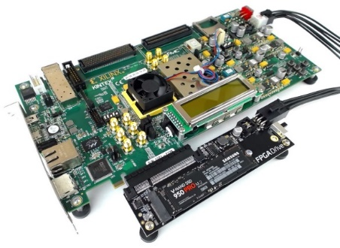
Our FPGA-based Filter: GateKeeper
1
st
Alignment Filter
FPGA-based Alignment Filter.
Notes:
To bridge the widening gap between the sequencer & the mapper, we propose the concept of pre-alignment filtering. We added a new examination step before the accurate alignment step. The main objective of this step is to detect the incorrect mappings accurately and rapidly. Only the mappings that pass our filter are examined by the alignment step. We also explore exploiting todays’ hardware accelerators to further boost the filtering speed of such filters.

Slide 30
FPGA-Based Alignment Filtering
Mohammed Alser, Hasan Hassan, Hongyi Xin, Oguz Ergin, Onur Mutlu, and Can Alkan "GateKeeper: A New Hardware Architecture for Accelerating Pre-Alignment in DNA Short Read Mapping" Bioinformatics, [published online, May 31], 2017. [Source Code] [Online link at Bioinformatics Journal]

Slide 31
DNA Read Mapping & Filtering
Problem: Heavily bottlenecked by Data Movement
GateKeeper FPGA performance limited by DRAM bandwidth [Alser+, Bioinformatics 2017]
Ditto for SHD on SIMD [Xin+, Bioinformatics 2015]
Solution: Processing-in-memory can alleviate the bottleneck
However, we need to design mapping & filtering algorithms to fit processing-in-memory

Slide 32
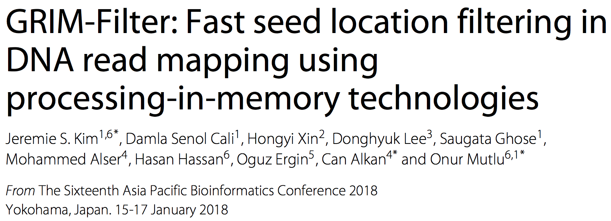
In-Memory DNA Sequence Analysis
Jeremie S. Kim, Damla Senol Cali, Hongyi Xin, Donghyuk Lee, Saugata Ghose, Mohammed Alser, Hasan Hassan, Oguz Ergin, Can Alkan, and Onur Mutlu, "GRIM-Filter: Fast Seed Location Filtering in DNA Read Mapping Using Processing-in-Memory Technologies" BMC Genomics, 2018. Proceedings of the 16th Asia Pacific Bioinformatics Conference (APBC), Yokohama, Japan, January 2018. arxiv.org Version (pdf)

Slide 33
Key Principles and Results
Two key principles:
Exploit the structure of the genome to minimize computation
Morph and exploit the structure of the underlying hardware to maximize performance and efficiency
Algorithm-architecture co-design for DNA read mapping
Speeds up read mapping by ~200X (sometimes more)
Improves accuracy of read mapping in the presence of errors
Xin et al., “Accelerating Read Mapping with FastHASH,” BMC Genomics 2013.
Xin et al., “Shifted Hamming Distance: A Fast and Accurate SIMD-friendly Filter to Accelerate
Alignment Verification in Read Mapping,” Bioinformatics 2015.
Alser et al., “GateKeeper: A New Hardware Architecture for Accelerating Pre-Alignment in DNA
Short Read Mapping,” Bioinformatics 2017.
Kim et al., “Genome Read In-Memory (GRIM) Filter,” BMC Genomics 2018.

Slide 34
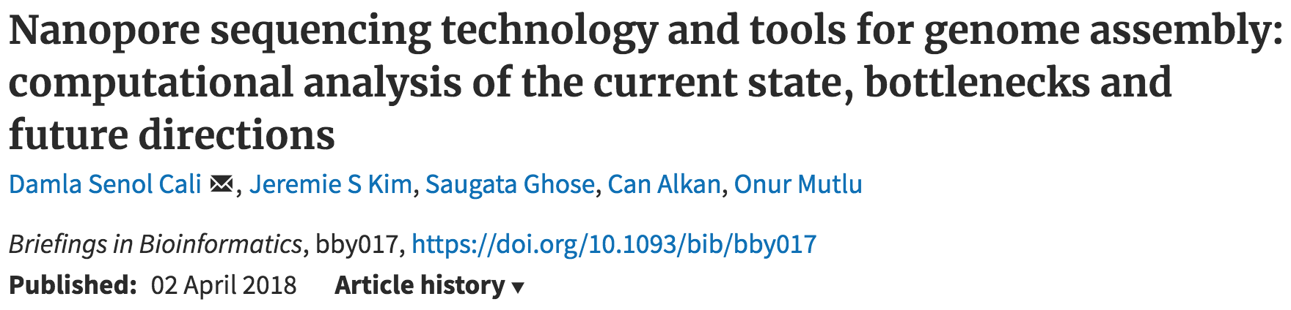
New Genome Sequencing Technologies
Oxford Nanopore MinION
Senol Cali+, “Nanopore Sequencing Technology and Tools for Genome
Assembly: Computational Analysis of the Current State, Bottlenecks
and Future Directions,” Briefings in Bioinformatics (BIB), 2018.
[Open arxiv.org version]

Slide 35
Nanopore Genome Assembly Pipeline
Senol Cali+, “Nanopore Sequencing Technology and Tools for Genome
Assembly”, Briefings in Bioinformatics, 2018. [Open arxiv.org version]

Slide 36

More on Genome Analysis: Another Talk

Slide 37
Recall Our Dream
Can we build devices that can analyze a genome within a minute?
Still a long ways to go
Energy efficiency
Performance (latency)
Security
Huge memory bottleneck

Slide 38
Four Key Directions
Fundamentally Secure/Reliable/Safe Architectures
Fundamentally Energy-Efficient Architectures
Memory-centric (Data-centric) Architectures
Fundamentally Low-Latency Architectures
Architectures for Genomics, Medicine, Health

Slide 39
Memory & Storage

Slide 40
Why Is Memory So Important? (Especially Today)

Slide 41
Importance of Main Memory
The Performance Perspective
The Energy Perspective
The Scaling/Reliability/Security Perspective
Trends/Challenges/Opportunities in Main Memory

Slide 42
The Main Memory System
Main memory is a critical component of all computing systems: server, mobile, embedded, desktop, sensor
Main memory system must scale (in size, technology, efficiency, cost, and management algorithms) to maintain performance growth and technology scaling benefits
Processors
and caches
Main Memory
Storage (SSD/HDD)

Slide 43
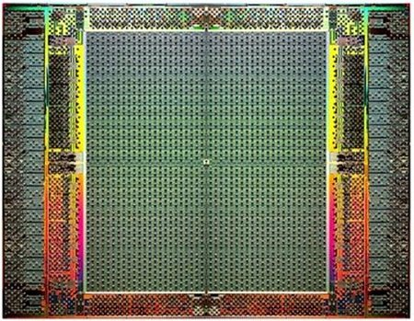
The Main Memory System
Main memory is a critical component of all computing systems: server, mobile, embedded, desktop, sensor
Main memory system must scale (in size, technology, efficiency, cost, and management algorithms) to maintain performance growth and technology scaling benefits
FPGAs
Main Memory
Storage (SSD/HDD)

Slide 44
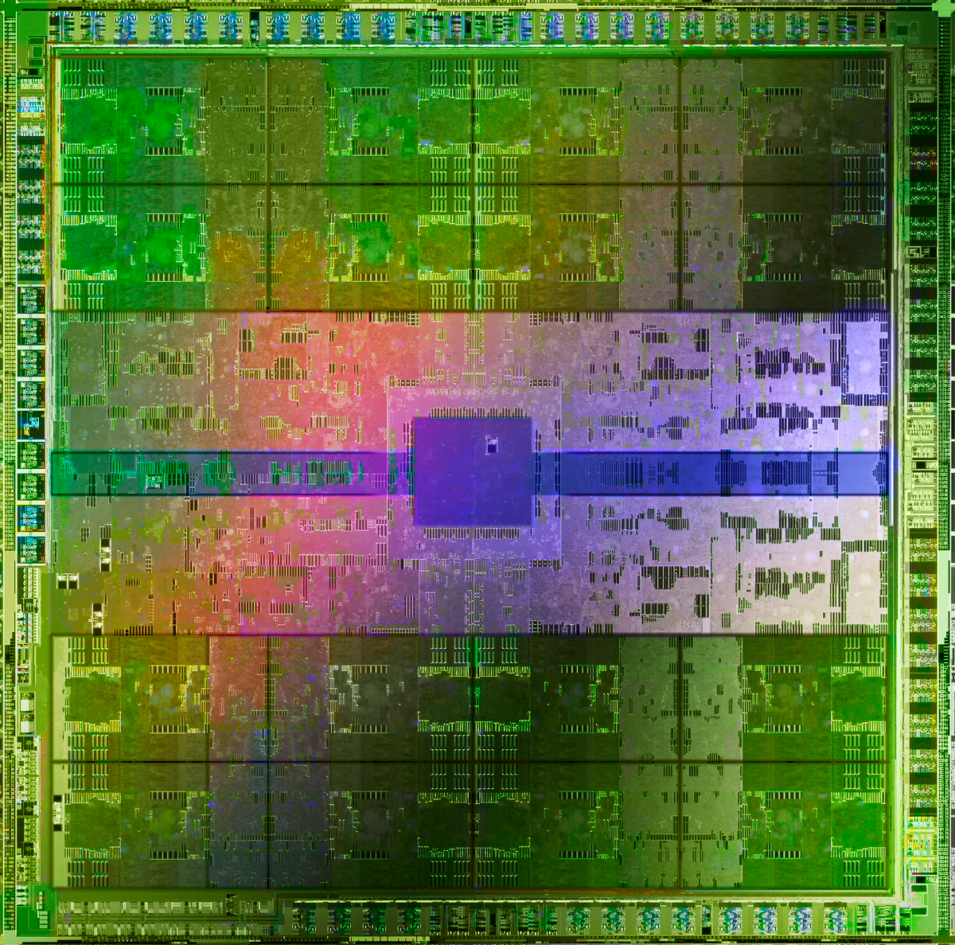
The Main Memory System
Main memory is a critical component of all computing systems: server, mobile, embedded, desktop, sensor
Main memory system must scale (in size, technology, efficiency, cost, and management algorithms) to maintain performance growth and technology scaling benefits
GPUs
Main Memory
Storage (SSD/HDD)

Slide 45
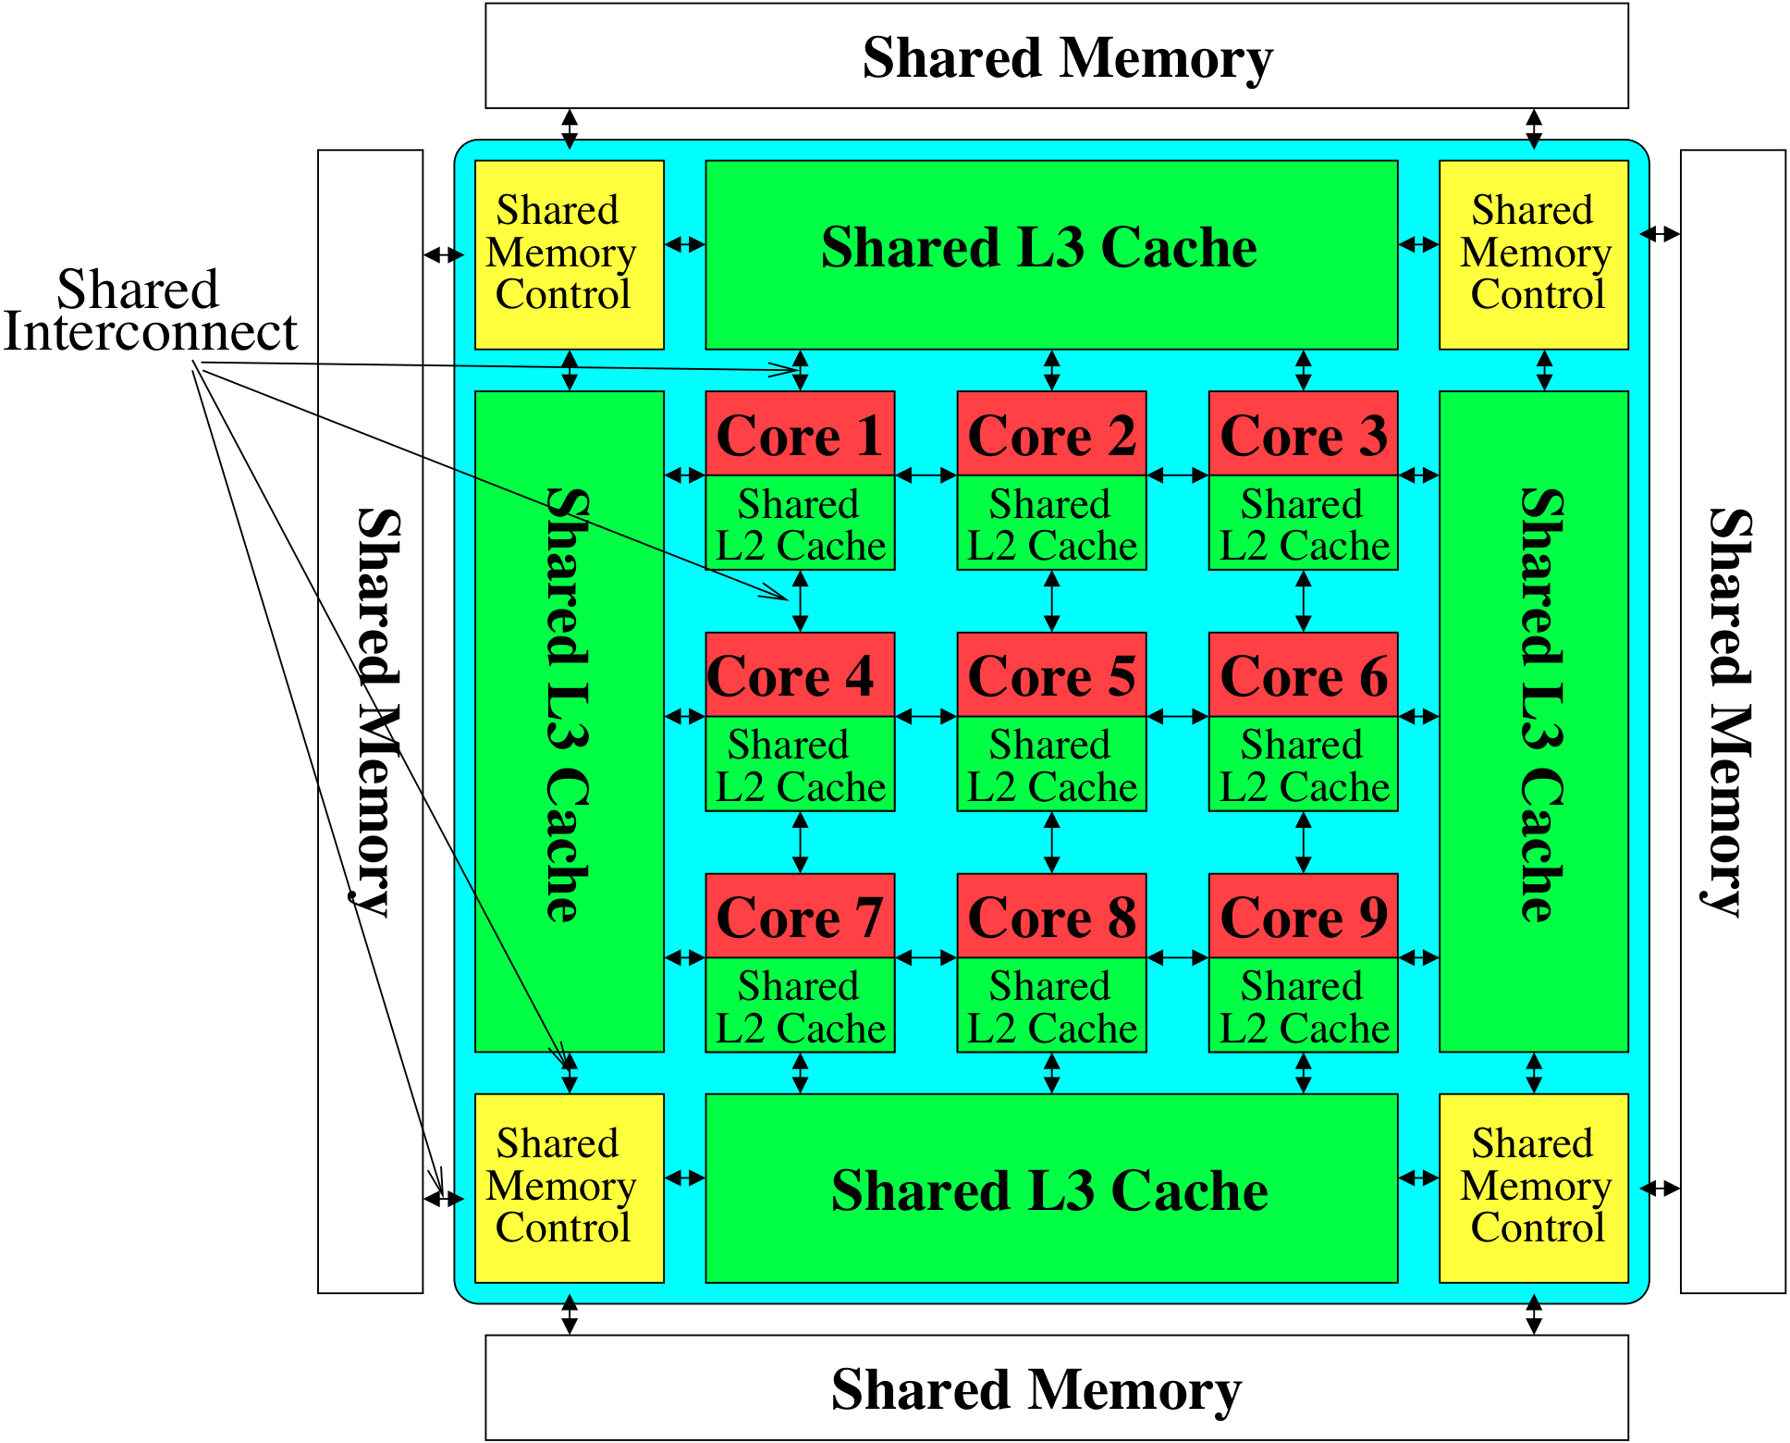
Memory System: A Shared Resource View
Storage
Most of the system is dedicated to storing and moving data

Slide 46
State of the Main Memory System
Recent technology, architecture, and application trends
lead to new requirements
exacerbate old requirements
DRAM and memory controllers, as we know them today, are (will be) unlikely to satisfy all requirements
Some emerging non-volatile memory technologies (e.g., PCM) enable new opportunities: memory+storage merging
We need to rethink the main memory system
to fix DRAM issues and enable emerging technologies
to satisfy all requirements

Slide 47
Major Trends Affecting Main Memory (I)
Need for main memory capacity, bandwidth, QoS increasing
Main memory energy/power is a key system design concern
DRAM technology scaling is ending

Slide 48
Major Trends Affecting Main Memory (II)
Need for main memory capacity, bandwidth, QoS increasing
Multi-core: increasing number of cores/agents
Data-intensive applications: increasing demand/hunger for data
Consolidation: cloud computing, GPUs, mobile, heterogeneity
Main memory energy/power is a key system design concern
DRAM technology scaling is ending

Slide 49
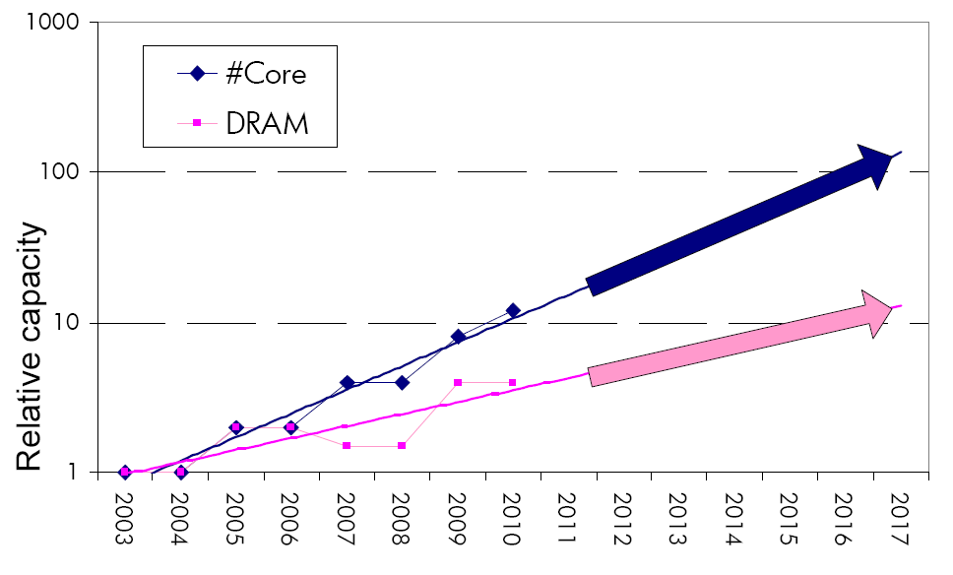
Consequence: The Memory Capacity Gap
Core count doubling ~ every 2 years
DRAM DIMM capacity doubling ~ every 3 years
Memory capacity per core expected to drop by 30% every two years
Trends worse for memory bandwidth per core!
Lim et al., ISCA 2009

Slide 50
Example: Capacity, Bandwidth & Latency
128x
20x
1.3x
Memory latency remains almost constant

Slide 51
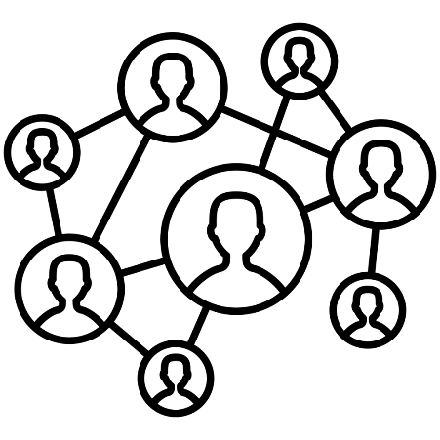



DRAM Latency Is Critical for Performance
In-memory Databases
[Mao+, EuroSys’12; Clapp+ (Intel), IISWC’15]
Graph/Tree Processing
[Xu+, IISWC’12; Umuroglu+, FPL’15]
In-Memory Data Analytics
[Clapp+ (Intel), IISWC’15;
Awan+, BDCloud’15]
Datacenter Workloads [Kanev+ (Google), ISCA’15]

Slide 52
DRAM Latency Is Critical for Performance
In-memory Databases
[Mao+, EuroSys’12; Clapp+ (Intel), IISWC’15]
Graph/Tree Processing
[Xu+, IISWC’12; Umuroglu+, FPL’15]
Long memory latency → performance bottleneck
In-Memory Data Analytics
[Clapp+ (Intel), IISWC’15;
Awan+, BDCloud’15]
Datacenter Workloads [Kanev+ (Google), ISCA’15]

Slide 53
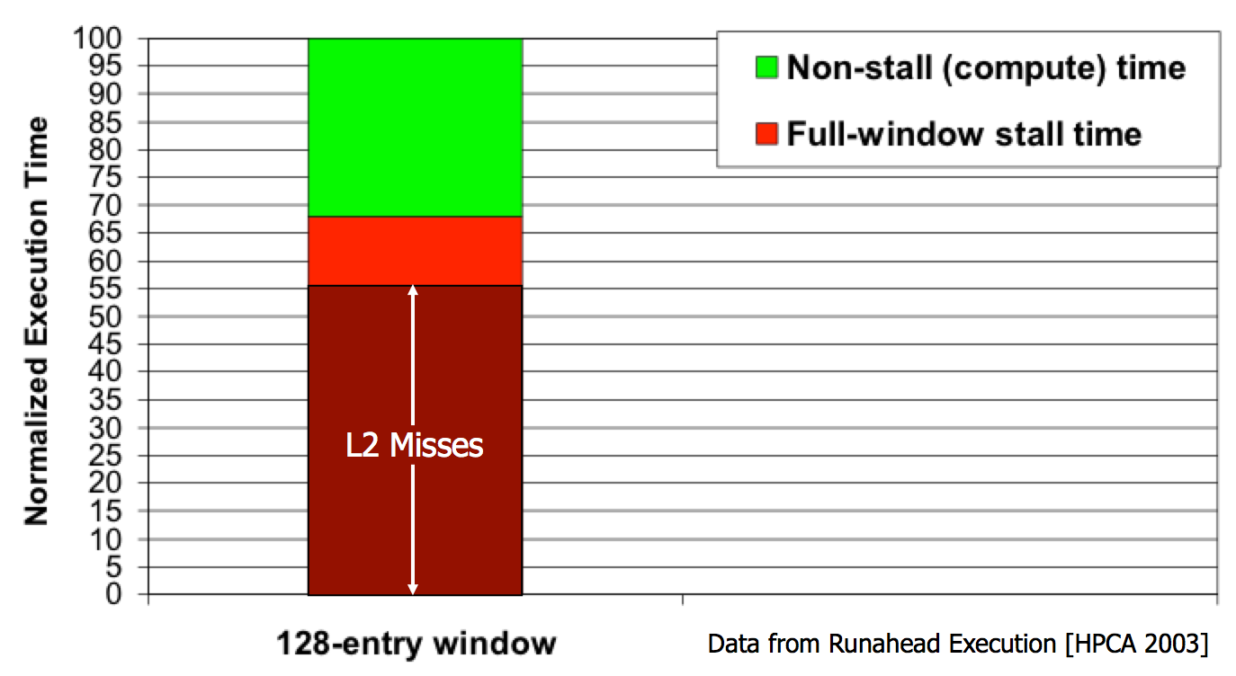
Performance Cost of Data Movement
“It’s the Memory, Stupid!” (Richard Sites, MPR, 1996)
Mutlu+, “Runahead Execution: An Alternative to Very Large Instruction Windows for Out-of-Order Processors,” HPCA 2003.

Slide 54
Major Trends Affecting Main Memory (III)
Need for main memory capacity, bandwidth, QoS increasing
Main memory energy/power is a key system design concern
~40-50% energy spent in off-chip memory hierarchy [Lefurgy, IEEE Computer’03] >40% power in DRAM [Ware, HPCA’10][Paul,ISCA’15]
DRAM consumes power even when not used (periodic refresh)
DRAM technology scaling is ending

Slide 55
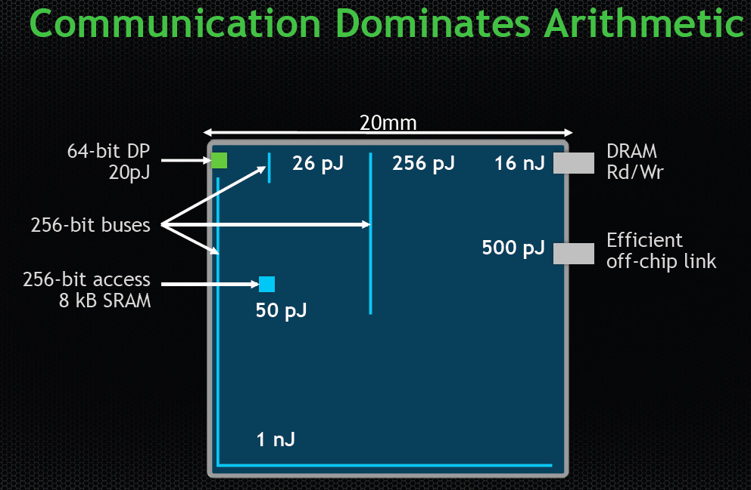
Energy Cost of Data Movement
Dally, HiPEAC 2015
A memory access consumes ~1000X
the energy of a complex addition

Slide 56
Major Trends Affecting Main Memory (IV)
Need for main memory capacity, bandwidth, QoS increasing
Main memory energy/power is a key system design concern
DRAM technology scaling is ending
ITRS projects DRAM will not scale easily below X nm
Scaling has provided many benefits:
higher capacity (density), lower cost, lower energy

Slide 57
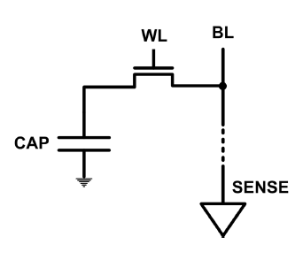
The DRAM Scaling Problem
DRAM stores charge in a capacitor (charge-based memory)
Capacitor must be large enough for reliable sensing
Access transistor should be large enough for low leakage and high retention time
Scaling beyond 40-35nm (2013) is challenging [ITRS, 2009]
DRAM capacity, cost, and energy/power hard to scale

Slide 58
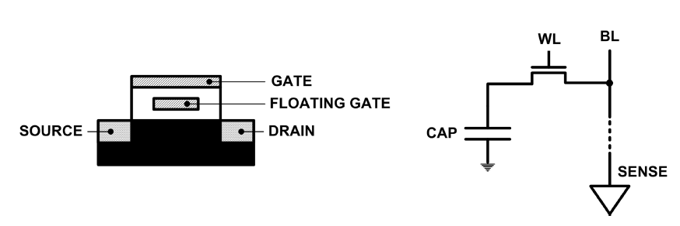
Limits of Charge Memory
Difficult charge placement and control
Flash: floating gate charge
DRAM: capacitor charge, transistor leakage
Reliable sensing becomes difficult as charge storage unit size reduces

Slide 59

As Memory Scales, It Becomes Unreliable
Data from all of Facebook’s servers worldwide
Meza+, “Revisiting Memory Errors in Large-Scale Production Data Centers,” DSN’15.
Intuition: quadratic increase in capacity

Slide 60

Large-Scale Failure Analysis of DRAM Chips
Analysis and modeling of memory errors found in all of Facebook’s server fleet
Justin Meza, Qiang Wu, Sanjeev Kumar, and Onur Mutlu, "Revisiting Memory Errors in Large-Scale Production Data Centers: Analysis and Modeling of New Trends from the Field" Proceedings of the 45th Annual IEEE/IFIP International Conference on Dependable Systems and Networks (DSN), Rio de Janeiro, Brazil, June 2015. [Slides (pptx) (pdf)] [DRAM Error Model]

Slide 61

Infrastructures to Understand Such Issues
Temperature
Controller
FPGAs
Heater
FPGAs
PC
Kim+, “Flipping Bits in Memory Without Accessing Them: An Experimental Study of DRAM Disturbance Errors,” ISCA 2014.

Slide 62


SoftMC: Open Source DRAM Infrastructure
Hasan Hassan et al., “SoftMC: A Flexible and Practical Open-Source Infrastructure for Enabling Experimental DRAM Studies,” HPCA 2017.
Flexible
Easy to Use (C++ API)
Open-source
github.com/CMU-SAFARI/SoftMC

Slide 63

SoftMC
https://github.com/CMU-SAFARI/SoftMC

Slide 64
A Curious Discovery [Kim et al., ISCA 2014]
One can
predictably induce errors
in most DRAM memory chips

Slide 65

DRAM RowHammer
A simple hardware failure mechanism
can create a widespread
system security vulnerability

Slide 66

The Reliability & Security Perspectives
Onur Mutlu, "The RowHammer Problem and Other Issues We May Face as Memory Becomes Denser" Invited Paper in Proceedings of the Design, Automation, and Test in Europe Conference (DATE), Lausanne, Switzerland, March 2017. [Slides (pptx) (pdf)]
https://people.inf.ethz.ch/omutlu/pub/rowhammer-and-other-memory-issues_date17.pdf

Slide 67
Major Trends Affecting Main Memory (V)
DRAM scaling has already become increasingly difficult
Increasing cell leakage current, reduced cell reliability, increasing manufacturing difficulties [Kim+ ISCA 2014], [Liu+ ISCA 2013], [Mutlu IMW 2013], [Mutlu DATE 2017]
Difficult to significantly improve capacity, energy
Emerging memory technologies are promising
3D-Stacked DRAM | higher bandwidth | smaller capacity
Reduced-Latency DRAM (e.g., RLDRAM, TL-DRAM) | lower latency | higher cost
Low-Power DRAM (e.g., LPDDR3, LPDDR4) | lower power | higher latency higher cost
Non-Volatile Memory (NVM) (e.g., PCM, STTRAM, ReRAM, 3D Xpoint) | larger capacity | higher latency higher dynamic power lower endurance

Slide 68
Major Trends Affecting Main Memory (V)
DRAM scaling has already become increasingly difficult
Increasing cell leakage current, reduced cell reliability, increasing manufacturing difficulties [Kim+ ISCA 2014], [Liu+ ISCA 2013], [Mutlu IMW 2013], [Mutlu DATE 2017]
Difficult to significantly improve capacity, energy
Emerging memory technologies are promising
3D-Stacked DRAM | higher bandwidth | smaller capacity
Reduced-Latency DRAM (e.g., RL/TL-DRAM, FLY-RAM) | lower latency | higher cost
Low-Power DRAM (e.g., LPDDR3, LPDDR4, Voltron) | lower power | higher latency higher cost
Non-Volatile Memory (NVM) (e.g., PCM, STTRAM, ReRAM, 3D Xpoint) | larger capacity | higher latency higher dynamic power lower endurance

Slide 69
Major Trend: Hybrid Main Memory
CPU
Meza+, “Enabling Efficient and Scalable Hybrid Memories,” IEEE Comp. Arch. Letters, 2012.
Yoon+, “Row Buffer Locality Aware Caching Policies for Hybrid Memories,” ICCD 2012 Best Paper Award.
DRAMCtrl
PCM Ctrl
DRAM
Phase Change Memory (or Tech. X)
Fast, durable
Small,
leaky, volatile,
high-cost
Large, non-volatile, low-cost
Slow, wears out, high active energy
Hardware/software manage data allocation and movement
to achieve the best of multiple technologies

Slide 70
One Foreshadowing
Main Memory Needs
Intelligent Controllers

Slide 71

Industry Is Writing Papers About It, Too

Slide 72

Call for Intelligent Memory Controllers

Slide 73
An Orthogonal Issue: Memory Interference
Main
Memory
Core
Core
Core
Core
Cores’ interfere with each other when accessing shared main memory
Uncontrolled interference leads to many problems (QoS, performance)
Notes:
In a multicore system, multiple applications running on the different cores share the main memory.
These applications interfere at the main memory. The result of this interference is unpredictable application slowdowns.

Slide 74
Goal: Predictable Performance in Complex Systems
CPU
CPU
CPU
CPU
GPU
HWA
HWA
Shared Cache
DRAM and Hybrid Memory Controllers
DRAM and Hybrid Memories
Heterogeneous agents: CPUs, GPUs, and HWAs
Main memory interference between CPUs, GPUs, HWAs
How to allocate resources to heterogeneous agents
to mitigate interference and provide predictable performance?

Slide 75
One Foreshadowing
Main Memory Needs
Intelligent Controllers

Slide 76
Trends, Challenges, and Opportunities in Main Memory

Slide 77
How Do We Solve The Memory Problem?
Fix it: Make memory and controllers more intelligent
New interfaces, functions, architectures: system-mem codesign
Eliminate or minimize it: Replace or (more likely) augment DRAM with a different technology
New technologies and system-wide rethinking of memory & storage
Embrace it: Design heterogeneous memories (none of which are perfect) and map data intelligently across them
New models for data management and maybe usage
…
Problems
Algorithms
Programs
User
Runtime System
(VM, OS, MM)
ISA
Microarchitecture
Logic
Devices
Solutions (to memory scaling) require
software/hardware/device cooperation

Slide 78
Solution 1: New Memory Architectures
Overcome memory shortcomings with
Memory-centric system design
Novel memory architectures, interfaces, functions
Better waste management (efficient utilization)
Key issues to tackle
Enable reliability at low cost → high capacity
Reduce energy
Reduce latency
Improve bandwidth
Reduce waste (capacity, bandwidth, latency)
Enable computation close to data

Slide 79
Solution 1: New Memory Architectures
Liu+, “RAIDR: Retention-Aware Intelligent DRAM Refresh,” ISCA 2012.
Kim+, “A Case for Exploiting Subarray-Level Parallelism in DRAM,” ISCA 2012.
Lee+, “Tiered-Latency DRAM: A Low Latency and Low Cost DRAM Architecture,” HPCA 2013.
Liu+, “An Experimental Study of Data Retention Behavior in Modern DRAM Devices,” ISCA 2013.
Seshadri+, “RowClone: Fast and Efficient In-DRAM Copy and Initialization of Bulk Data,” MICRO 2013.
Pekhimenko+, “Linearly Compressed Pages: A Main Memory Compression Framework,” MICRO 2013.
Chang+, “Improving DRAM Performance by Parallelizing Refreshes with Accesses,” HPCA 2014.
Khan+, “The Efficacy of Error Mitigation Techniques for DRAM Retention Failures: A Comparative Experimental Study,” SIGMETRICS 2014.
Luo+, “Characterizing Application Memory Error Vulnerability to Optimize Data Center Cost,” DSN 2014.
Kim+, “Flipping Bits in Memory Without Accessing Them: An Experimental Study of DRAM Disturbance Errors,” ISCA 2014.
Lee+, “Adaptive-Latency DRAM: Optimizing DRAM Timing for the Common-Case,” HPCA 2015.
Qureshi+, “AVATAR: A Variable-Retention-Time (VRT) Aware Refresh for DRAM Systems,” DSN 2015.
Meza+, “Revisiting Memory Errors in Large-Scale Production Data Centers: Analysis and Modeling of New Trends from the Field,” DSN 2015.
Kim+, “Ramulator: A Fast and Extensible DRAM Simulator,” IEEE CAL 2015.
Seshadri+, “Fast Bulk Bitwise AND and OR in DRAM,” IEEE CAL 2015.
Ahn+, “A Scalable Processing-in-Memory Accelerator for Parallel Graph Processing,” ISCA 2015.
Ahn+, “PIM-Enabled Instructions: A Low-Overhead, Locality-Aware Processing-in-Memory Architecture,” ISCA 2015.
Lee+, “Decoupled Direct Memory Access: Isolating CPU and IO Traffic by Leveraging a Dual-Data-Port DRAM,” PACT 2015.
Seshadri+, “Gather-Scatter DRAM: In-DRAM Address Translation to Improve the Spatial Locality of Non-unit Strided Accesses,” MICRO 2015.
Lee+, “Simultaneous Multi-Layer Access: Improving 3D-Stacked Memory Bandwidth at Low Cost,” TACO 2016.
Hassan+, “ChargeCache: Reducing DRAM Latency by Exploiting Row Access Locality,” HPCA 2016.
Chang+, “Low-Cost Inter-Linked Subarrays (LISA): Enabling Fast Inter-Subarray Data Migration in DRAM,” HPCA 2016.
Chang+, “Understanding Latency Variation in Modern DRAM Chips Experimental Characterization, Analysis, and Optimization,” SIGMETRICS 2016.
Khan+, “PARBOR: An Efficient System-Level Technique to Detect Data Dependent Failures in DRAM,” DSN 2016.
Hsieh+, “Transparent Offloading and Mapping (TOM): Enabling Programmer-Transparent Near-Data Processing in GPU Systems,” ISCA 2016.
Hashemi+, “Accelerating Dependent Cache Misses with an Enhanced Memory Controller,” ISCA 2016.
Boroumand+, “LazyPIM: An Efficient Cache Coherence Mechanism for Processing-in-Memory,” IEEE CAL 2016.
Pattnaik+, “Scheduling Techniques for GPU Architectures with Processing-In-Memory Capabilities,” PACT 2016.
Hsieh+, “Accelerating Pointer Chasing in 3D-Stacked Memory: Challenges, Mechanisms, Evaluation,” ICCD 2016.
Hashemi+, “Continuous Runahead: Transparent Hardware Acceleration for Memory Intensive Workloads,” MICRO 2016.
Khan+, “A Case for Memory Content-Based Detection and Mitigation of Data-Dependent Failures in DRAM",” IEEE CAL 2016.
Hassan+, “SoftMC: A Flexible and Practical Open-Source Infrastructure for Enabling Experimental DRAM Studies,” HPCA 2017.
Mutlu, “The RowHammer Problem and Other Issues We May Face as Memory Becomes Denser,” DATE 2017.
Lee+, “Design-Induced Latency Variation in Modern DRAM Chips: Characterization, Analysis, and Latency Reduction Mechanisms,” SIGMETRICS 2017.
Chang+, “Understanding Reduced-Voltage Operation in Modern DRAM Devices: Experimental Characterization, Analysis, and Mechanisms,” SIGMETRICS 2017.
Patel+, “The Reach Profiler (REAPER): Enabling the Mitigation of DRAM Retention Failures via Profiling at Aggressive Conditions,” ISCA 2017.
Seshadri and Mutlu, “Simple Operations in Memory to Reduce Data Movement,” ADCOM 2017.
Liu+, “Concurrent Data Structures for Near-Memory Computing,” SPAA 2017.
Khan+, “Detecting and Mitigating Data-Dependent DRAM Failures by Exploiting Current Memory Content,” MICRO 2017.
Seshadri+, “Ambit: In-Memory Accelerator for Bulk Bitwise Operations Using Commodity DRAM Technology,” MICRO 2017.
Kim+, “GRIM-Filter: Fast Seed Location Filtering in DNA Read Mapping Using Processing-in-Memory Technologies,” BMC Genomics 2018.
Kim+, “The DRAM Latency PUF: Quickly Evaluating Physical Unclonable Functions by Exploiting the Latency-Reliability Tradeoff in Modern DRAM Devices,” HPCA 2018.
Boroumand+, “Google Workloads for Consumer Devices: Mitigating Data Movement Bottlenecks,” ASPLOS 2018.
Das+, “VRL-DRAM: Improving DRAM Performance via Variable Refresh Latency,” DAC 2018.
Ghose+, “What Your DRAM Power Models Are Not Telling You: Lessons from a Detailed Experimental Study,” SIGMETRICS 2018.
Kim+, “Solar-DRAM: Reducing DRAM Access Latency by Exploiting the Variation in Local Bitlines,” ICCD 2018.
Wang+, “Reducing DRAM Latency via Charge-Level-Aware Look-Ahead Partial Restoration,” MICRO 2018.
Avoid DRAM:
Seshadri+, “The Evicted-Address Filter: A Unified Mechanism to Address Both Cache Pollution and Thrashing,” PACT 2012.
Pekhimenko+, “Base-Delta-Immediate Compression: Practical Data Compression for On-Chip Caches,” PACT 2012.
Seshadri+, “The Dirty-Block Index,” ISCA 2014.
Pekhimenko+, “Exploiting Compressed Block Size as an Indicator of Future Reuse,” HPCA 2015.
Vijaykumar+, “A Case for Core-Assisted Bottleneck Acceleration in GPUs: Enabling Flexible Data Compression with Assist Warps,” ISCA 2015.
Pekhimenko+, “Toggle-Aware Bandwidth Compression for GPUs,” HPCA 2016.

Slide 80

Solution 2: Emerging Memory Technologies
Some emerging resistive memory technologies seem more scalable than DRAM (and they are non-volatile)
Example: Phase Change Memory
Data stored by changing phase of material
Data read by detecting material’s resistance
Expected to scale to 9nm (2022 [ITRS 2009])
Prototyped at 20nm (Raoux+, IBM JRD 2008)
Expected to be denser than DRAM: can store multiple bits/cell
But, emerging technologies have (many) shortcomings
Can they be enabled to replace/augment/surpass DRAM?
Notes:
Even if DRAM continues to scale there could be benefits to examining and enabling these new technologies.

Slide 81
Solution 2: Emerging Memory Technologies
Lee+, “Architecting Phase Change Memory as a Scalable DRAM Alternative,” ISCA’09, CACM’10, IEEE Micro’10.
Meza+, “Enabling Efficient and Scalable Hybrid Memories,” IEEE Comp. Arch. Letters 2012.
Yoon, Meza+, “Row Buffer Locality Aware Caching Policies for Hybrid Memories,” ICCD 2012.
Kultursay+, “Evaluating STT-RAM as an Energy-Efficient Main Memory Alternative,” ISPASS 2013.
Meza+, “A Case for Efficient Hardware-Software Cooperative Management of Storage and Memory,” WEED 2013.
Lu+, “Loose Ordering Consistency for Persistent Memory,” ICCD 2014.
Zhao+, “FIRM: Fair and High-Performance Memory Control for Persistent Memory Systems,” MICRO 2014.
Yoon, Meza+, “Efficient Data Mapping and Buffering Techniques for Multi-Level Cell Phase-Change Memories,” TACO 2014.
Ren+, “ThyNVM: Enabling Software-Transparent Crash Consistency in Persistent Memory Systems,” MICRO 2015.
Chauhan+, “NVMove: Helping Programmers Move to Byte-Based Persistence,” INFLOW 2016.
Li+, “Utility-Based Hybrid Memory Management,” CLUSTER 2017.
Yu+, “Banshee: Bandwidth-Efficient DRAM Caching via Software/Hardware Cooperation,” MICRO 2017.
Notes:
Even if DRAM continues to scale there could be benefits to examining and enabling these new technologies.

Slide 82
Combination: Hybrid Memory Systems
CPU
Meza+, “Enabling Efficient and Scalable Hybrid Memories,” IEEE Comp. Arch. Letters, 2012.
Yoon, Meza et al., “Row Buffer Locality Aware Caching Policies for Hybrid Memories,” ICCD 2012 Best Paper Award.
DRAMCtrl
PCM Ctrl
DRAM
Technology X (e.g., PCM)
Fast, durable
Small,
leaky, volatile,
high-cost
Large, non-volatile, low-cost
Slow, wears out, high active energy
Hardware/software manage data allocation and movement
to achieve the best of multiple technologies

Slide 83

Exploiting Memory Error Tolerance with Hybrid Memory Systems
Heterogeneous-Reliability Memory [DSN 2014]
Vulnerable data
Vulnerable data
Tolerant data
Tolerant data
Reliable memory
Low-cost memory
Vulnerable data
On Microsoft’s Web Search workload
Reduces server hardware cost by 4.7 %
Achieves single server availability target of 99.90 %
ECC protected
Well-tested chips
Tolerant data
NoECC or Parity
Less-tested chips
Notes:
As we have shown earlier, either across or within applications, our characterization can identify data that are vulnerable to memory errors and data that are tolerant to memory errors.
To exploit this observation, we would like to map these different data onto different memory modules according to their memory error tolerance.
As an example here, we map vulnerable data to reliable memory to improve reliability, and map tolerant data to low-cost less-reliable memory to exploit its tolerance and lower the cost. We call this mechanism heterogeneous-reliability memory, HRM.
Reliable memory consists of … Low cost memory consists of …
As we will show later, HRM allows us to use weaker error protection in memory, and enables the use of less-tested memory chips to lower the cost of the memory system, while still achieving reasonable single-server reliability target.

Slide 84

More on Heterogeneous Reliability Memory
Yixin Luo, Sriram Govindan, Bikash Sharma, Mark Santaniello, Justin Meza, Aman Kansal, Jie Liu, Badriddine Khessib, Kushagra Vaid, and Onur Mutlu, "Characterizing Application Memory Error Vulnerability to Optimize Data Center Cost via Heterogeneous-Reliability Memory" Proceedings of the 44th Annual IEEE/IFIP International Conference on Dependable Systems and Networks (DSN), Atlanta, GA, June 2014. [Summary] [Slides (pptx) (pdf)] [Coverage on ZDNet]

Slide 85
An Orthogonal Issue: Memory Interference
Problem: Memory interference between cores is uncontrolled
→ unfairness, starvation, low performance
→ uncontrollable, unpredictable, vulnerable system
Solution: QoS-Aware Memory Systems
Hardware designed to provide a configurable fairness substrate
Application-aware memory scheduling, partitioning, throttling
Software designed to configure the resources to satisfy different QoS goals
QoS-aware memory systems can provide predictable performance and higher efficiency

Slide 86
Strong Memory Service Guarantees
Goal: Satisfy performance/SLA requirements in the presence of shared main memory, heterogeneous agents, and hybrid memory/storage
Approach:
Develop techniques/models to accurately estimate the performance loss of an application/agent in the presence of resource sharing
Develop mechanisms (hardware and software) to enable the resource partitioning/prioritization needed to achieve the required performance levels for all applications
All the while providing high system performance
Subramanian et al., “MISE: Providing Performance Predictability and Improving Fairness in Shared Main Memory Systems,” HPCA 2013.
Subramanian et al., “The Application Slowdown Model,” MICRO 2015.

Slide 87
Agenda for Today
Brief Introduction
A Motivating Example
Memory System Trends and Opportunities
What Will You Learn In This Course
And, how to make the best of it…
Memory Fundamentals
Key Memory Challenges and Solution Directions
Security, Reliability, Safety
…
…
Summary and Future Lookout

Slide 88
Memory Systems Fundamentals, Recent Research, Challenges, Opportunities Lecture 1a: Memory Importance and Trends
Prof. Onur Mutlu
omutlu@gmail.com
https://people.inf.ethz.ch/omutlu
8 October 2018
Technion Fast Course 2018

Slide 89
Memory Systems Fundamentals, Recent Research, Challenges, Opportunities Lecture 1b: Course Logistics
Prof. Onur Mutlu
omutlu@gmail.com
https://people.inf.ethz.ch/omutlu
8 October 2018
Technion Fast Course 2018

Slide 90
Course Logistics

Slide 91
What Will You Learn in This Course?
Memory Systems
October 8-12, 2018
Topic 1: Main Memory Trends and Fundamentals
Topic 2: Memory Reliability & Security: RowHammer and Beyond
Topic 3: In-memory Computation
Topic 4: Low-Latency and Low-Energy Memory
Topic 5: Enabling and Exploiting Emerging Memory Technologies
Topic 6: Flash Memory and SSD Scaling
Topic 7: Memory Interference and QoS
Topic 8: Energy-efficient Interconnects

Slide 92
This Course
Will cover many problems and potential solutions related to the design of memory systems in the many core era
The design of the memory system poses many
Difficult research and engineering problems
Important fundamental problems
Industry-relevant problems
Problems whose solutions can revolutionize the world
Many creative and insightful solutions are needed to solve these problems
Goal: Acquire the basics to develop such solutions (by covering fundamentals and cutting edge research)

Slide 93
Course Information
My Contact Information
Onur Mutlu
omutlu@gmail.com
https://people.inf.ethz.ch/omutlu
+41-79-572-1444 (my cell phone)
Find me during breaks and/or email any time.
Website for Course Slides, Papers, Updates
https://romankap.github.io/memory-systems-course
For the curious:
ACACES 2018: Memory Systems and Memory-Centric Computing Systems
https://people.inf.ethz.ch/omutlu/acaces2018.html

Slide 94

Course Staff
Onur Mutlu
Instructor
omutlu@gmail.com
Roman Kaplan
TA
romankap@gmail.com

Slide 95

How To Make the Best Out of This Course
Be alert during lectures – they will be fast paced
Do the readings (and explore even more)
I will provide many references + review assignments
Go back and reinforce fundamentals (as needed)
I will provide pointers to basic computer architecture materials (lecture videos, slides, readings, exams, …)
Remember “Chance favors the prepared mind.” (Pasteur)

Slide 96
How to Do a Good Paper Review

Slide 97
Anatomy of a Good Paper Review (Talk)
1: Summary
What is the problem the paper is trying to solve?
What are the key ideas of the paper? Key insights?
What are the key mechanisms? What is the implementation?
What are the key results? Key conclusions?
2: Strengths (most important ones)
Does the paper solve the problem well? Is it well written? …
3: Weaknesses (most important ones)
This is where you should think critically. Every paper/idea has a weakness. This does not mean the paper is necessarily bad. It means there is room for improvement and future research can accomplish this.
4: Thoughts/Ideas: Can you do better? Present your ideas.
5: Takeaways: What you learned/enjoyed/disliked? Why?
6: Discussion starters and questions.
Review should be short and concise (20 minutes or < one page)

Slide 98
Suggested Paper Discussion Format
Problem & Goal
Key Ideas/solution
Novelty
Mechanisms & Implementation
Major Results
Takeaways/Conclusions
Strengths
Weaknesses
Alternatives
New ideas/problems
Brainstorming and Discussion
~15-20 minute Summary
~10-15 min Critique
plus
~15 min Discussion

Slide 99
More Advice on Paper Review Talk
When doing the paper reviews and analyses, be very critical
Always think about better ways of solving the problem or related problems
Question the problem as well
Read background papers (both past and future)
This is how things progress in science and engineering (or anywhere), and how you can make big leaps
By critical analysis
A few sample text reviews will be provided online

Slide 100

Try to Avoid Rat Hole Discussions
Source: https://www.cse.wustl.edu/~jain/iucee/ftp/k_10adp.pdf

Slide 101
Aside: A Recommended Book

Slide 102

More Advice on Talks
Kayvon Fatahalian, “Tips for Giving Clear Talks”
http://graphics.stanford.edu/~kayvonf/misc/cleartalktips.pdf
Many useful and simple principles here

Slide 103
Who Painted This Painting?
Salvador Dali @ 1924
Source: http://www.museoreinasofia.es/en/collection/artwork/retrato-luis-bunuel-portrait-luis-bunuel http://salvadordaliprints.org/biography/

Slide 104
What About This?
Salvador Dali @ 1937
Source: http://salvadordaliprints.org/the-burning-giraffe/ https://www.dalipaintings.com/

Slide 105
Takeaway
Learn the basic principles
before you
consciously choose to break them

Slide 106
Readings, Videos, Reference Materials

Slide 107
Accelerated Memory Course (~6.5 hours)
ACACES 2018
Memory Systems and Memory-Centric Computing Systems
Taught by Onur Mutlu July 9-13, 2018
~6.5 hours of lectures
Website for the Course including Videos, Slides, Papers
https://people.inf.ethz.ch/omutlu/acaces2018.html
https://www.youtube.com/playlist?list=PL5Q2soXY2Zi-HXxomthrpDpMJm05P6J9x
All Papers are at:
https://people.inf.ethz.ch/omutlu/projects.htm
Final lecture notes and readings (for all topics)

Slide 108

Reference Overview Paper I
Saugata Ghose, Kevin Hsieh, Amirali Boroumand, Rachata Ausavarungnirun, Onur Mutlu, "Enabling the Adoption of Processing-in-Memory: Challenges, Mechanisms, Future Research Directions" Invited Book Chapter, to appear in 2018. [Preliminary arxiv.org version]
https://arxiv.org/pdf/1802.00320.pdf

Slide 109

Reference Overview Paper II
Onur Mutlu and Lavanya Subramanian, "Research Problems and Opportunities in Memory Systems" Invited Article in Supercomputing Frontiers and Innovations (SUPERFRI), 2014/2015.
https://people.inf.ethz.ch/omutlu/pub/memory-systems-research_superfri14.pdf

Slide 110
Reference Overview Paper III
Onur Mutlu, "The RowHammer Problem and Other Issues We May Face as Memory Becomes Denser" Invited Paper in Proceedings of the Design, Automation, and Test in Europe Conference (DATE), Lausanne, Switzerland, March 2017. [Slides (pptx) (pdf)]
https://people.inf.ethz.ch/omutlu/pub/rowhammer-and-other-memory-issues_date17.pdf

Slide 111

Reference Overview Paper IV
Onur Mutlu, "Memory Scaling: A Systems Architecture Perspective" Technical talk at MemCon 2013 (MEMCON), Santa Clara, CA, August 2013. [Slides (pptx) (pdf)] [Video] [Coverage on StorageSearch]
https://people.inf.ethz.ch/omutlu/pub/memory-scaling_memcon13.pdf

Slide 112

Reference Overview Paper V
Proceedings of the IEEE, Sept. 2017
https://arxiv.org/pdf/1706.08642

Slide 113
Related Videos and Course Materials (I)
Undergraduate Computer Architecture Course Lecture Videos (2015, 2014, 2013)
Undergraduate Computer Architecture Course Materials (2015, 2014, 2013)
Graduate Computer Architecture Course Lecture Videos (2017, 2015, 2013)
Graduate Computer Architecture Course Materials (2017, 2015, 2013)
Parallel Computer Architecture Course Materials (Lecture Videos)

Slide 114
Related Videos and Course Materials (II)
Freshman Digital Circuits and Computer Architecture Course Lecture Videos (2018, 2017)
Freshman Digital Circuits and Computer Architecture Course Materials (2018)
Memory Systems Short Course Materials
(Lecture Video on Main Memory and DRAM Basics)

Slide 115
Some Open Source Tools (I)
Rowhammer – Program to Induce RowHammer Errors
https://github.com/CMU-SAFARI/rowhammer
Ramulator – Fast and Extensible DRAM Simulator
https://github.com/CMU-SAFARI/ramulator
MemSim – Simple Memory Simulator
https://github.com/CMU-SAFARI/memsim
NOCulator – Flexible Network-on-Chip Simulator
https://github.com/CMU-SAFARI/NOCulator
SoftMC – FPGA-Based DRAM Testing Infrastructure
https://github.com/CMU-SAFARI/SoftMC
Other open-source software from my group
https://github.com/CMU-SAFARI/
http://www.ece.cmu.edu/~safari/tools.html

Slide 116
Some Open Source Tools (II)
MQSim – A Fast Modern SSD Simulator
https://github.com/CMU-SAFARI/MQSim
Mosaic – GPU Simulator Supporting Concurrent Applications
https://github.com/CMU-SAFARI/Mosaic
IMPICA – Processing in 3D-Stacked Memory Simulator
https://github.com/CMU-SAFARI/IMPICA
SMLA – Detailed 3D-Stacked Memory Simulator
https://github.com/CMU-SAFARI/SMLA
HWASim – Simulator for Heterogeneous CPU-HWA Systems
https://github.com/CMU-SAFARI/HWASim
Other open-source software from my group
https://github.com/CMU-SAFARI/
http://www.ece.cmu.edu/~safari/tools.html

Slide 117

More Open Source Tools (III)
A lot more open-source software from my group
https://github.com/CMU-SAFARI/
http://www.ece.cmu.edu/~safari/tools.html

Slide 118
Referenced Papers
All are available at
https://people.inf.ethz.ch/omutlu/projects.htm
http://scholar.google.com/citations?user=7XyGUGkAAAAJ&hl=en
https://people.inf.ethz.ch/omutlu/acaces2018.html
We will add papers here as we go along:
https://romankap.github.io/memory-systems-course

Slide 119
Grading

Slide 120
Grading
Final exam
Monday October 15 (10:00-12:00)
At least 3 paper reviews
5 recommended
Participation strongly encouraged

Slide 121
Memory Systems Fundamentals, Recent Research, Challenges, Opportunities Lecture 1b: Course Logistics
Prof. Onur Mutlu
omutlu@gmail.com
https://people.inf.ethz.ch/omutlu
8 October 2018
Technion Fast Course 2018

Slide 122
Memory Systems Fundamentals, Recent Research, Challenges, Opportunities Lecture 1c: Main Memory and DRAM Basics
Prof. Onur Mutlu
omutlu@gmail.com
https://people.inf.ethz.ch/omutlu
8 October 2018
Technion Fast Course 2018

Slide 123
Memory Fundamentals

Slide 124

Memory in a Modern System
CORE 0
L2 CACHE 1
CORE 1
L2 CACHE 0
SHARED L3 CACHE
DRAM INTERFACE
DRAM MEMORY CONTROLLER
DRAM BANKS
L2 CACHE 2
CORE 3
CORE 2
L2 CACHE 3

Slide 125
Ideal Memory
Zero access time (latency)
Infinite capacity
Zero cost
Infinite bandwidth (to support multiple accesses in parallel)

Slide 126
The Problem
Ideal memory’s requirements oppose each other
Bigger is slower
Bigger → Takes longer to determine the location
Faster is more expensive
Memory technology: SRAM vs. DRAM vs. Disk vs. Tape
Higher bandwidth is more expensive
Need more banks, more ports, higher frequency, or faster technology

Slide 127
Memory Technology: DRAM
Dynamic random access memory
Capacitor charge state indicates stored value
Whether the capacitor is charged or discharged indicates storage of 1 or 0
1 capacitor
1 access transistor
Capacitor leaks through the RC path
DRAM cell loses charge over time
DRAM cell needs to be refreshed
Read Liu et al., “RAIDR: Retention-aware Intelligent DRAM Refresh,” ISCA 2012.
row enable
_bitline

Slide 128
Memory Technology: SRAM
Static random access memory
Two cross coupled inverters store a single bit
Feedback path enables the stored value to persist in the “cell”
4 transistors for storage
2 transistors for access
row select
bitline
_bitline

Slide 129

An Aside: Phase Change Memory
Phase change material (chalcogenide glass) exists in two states:
Amorphous: Low optical reflexivity and high electrical resistivity
Crystalline: High optical reflexivity and low electrical resistivity
PCM is resistive memory: High resistance (0), Low resistance (1)
Lee, Ipek, Mutlu, Burger, “Architecting Phase Change Memory as a Scalable DRAM Alternative,” ISCA 2009.

Slide 130

Reading: PCM As Main Memory
Benjamin C. Lee, Engin Ipek, Onur Mutlu, and Doug Burger, "Architecting Phase Change Memory as a Scalable DRAM Alternative" Proceedings of the 36th International Symposium on Computer Architecture (ISCA), pages 2-13, Austin, TX, June 2009. Slides (pdf)

Slide 131

Reading: More on PCM As Main Memory
Benjamin C. Lee, Ping Zhou, Jun Yang, Youtao Zhang, Bo Zhao, Engin Ipek, Onur Mutlu, and Doug Burger, "Phase Change Technology and the Future of Main Memory" IEEE Micro, Special Issue: Micro's Top Picks from 2009 Computer Architecture Conferences (MICRO TOP PICKS), Vol. 30, No. 1, pages 60-70, January/February 2010.

Slide 132
Memory Bank: A Fundamental Concept
Interleaving (banking)
Problem: a single monolithic memory array takes long to access and does not enable multiple accesses in parallel
Goal: Reduce the latency of memory array access and enable multiple accesses in parallel
Idea: Divide the array into multiple banks that can be accessed independently (in the same cycle or in consecutive cycles)
Each bank is smaller than the entire memory storage
Accesses to different banks can be overlapped
An issue: How do you map data to different banks? (i.e., how do you interleave data across banks?)

Slide 133

Memory Bank Organization and Operation
Read access sequence:
1. Decode row address & drive word-lines
2. Selected bits drive bit-lines
• Entire row read
3. Amplify row data
4. Decode column address & select subset of row
• Send to output
5. Precharge bit-lines
• For next access

Slide 134
Why Memory Hierarchy?
We want both fast and large
But we cannot achieve both with a single level of memory
Idea: Have multiple levels of storage (progressively bigger and slower as the levels are farther from the processor) and ensure most of the data the processor needs is kept in the fast(er) level(s)

Slide 135
Memory Hierarchy
Fundamental tradeoff
Fast memory: small
Large memory: slow
Idea: Memory hierarchy
Latency, cost, size,
bandwidth
Hard Disk
Main
Memory
(DRAM)
CPU
Cache
RF

Slide 136
Caching Basics: Exploit Temporal Locality
Idea: Store recently accessed data in automatically managed fast memory (called cache)
Anticipation: the data will be accessed again soon
Temporal locality principle
Recently accessed data will be again accessed in the near future
This is what Maurice Wilkes had in mind:
Wilkes, “Slave Memories and Dynamic Storage Allocation,” IEEE Trans. On Electronic Computers, 1965.
“The use is discussed of a fast core memory of, say 32000 words as a slave to a slower core memory of, say, one million words in such a way that in practical cases the effective access time is nearer that of the fast memory than that of the slow memory.”

Slide 137
Caching Basics: Exploit Spatial Locality
Idea: Store addresses adjacent to the recently accessed one in automatically managed fast memory
Logically divide memory into equal size blocks
Fetch to cache the accessed block in its entirety
Anticipation: nearby data will be accessed soon
Spatial locality principle
Nearby data in memory will be accessed in the near future
E.g., sequential instruction access, array traversal
This is what IBM 360/85 implemented
16 Kbyte cache with 64 byte blocks
Liptay, “Structural aspects of the System/360 Model 85 II: the cache,” IBM Systems Journal, 1968.

Slide 138
A Note on Manual vs. Automatic Management
Manual: Programmer manages data movement across levels
-- too painful for programmers on substantial programs
“core” vs “drum” memory in the 50’s
still done in some embedded processors (on-chip scratch pad SRAM in lieu of a cache)
Automatic: Hardware manages data movement across levels, transparently to the programmer
++ programmer’s life is easier
simple heuristic: keep most recently used items in cache
the average programmer doesn’t need to know about it
You don’t need to know how big the cache is and how it works to write a “correct” program! (What if you want a “fast” program?)

Slide 139

Automatic Management in Memory Hierarchy
Wilkes, “Slave Memories and Dynamic Storage Allocation,” IEEE Trans. On Electronic Computers, 1965.
“By a slave memory I mean one which automatically accumulates to itself words that come from a slower main memory, and keeps them available for subsequent use without it being necessary for the penalty of main memory access to be incurred again.”

Slide 140
Historical Aside: Other Cache Papers
Fotheringham, “Dynamic Storage Allocation in the Atlas Computer, Including an Automatic Use of a Backing Store,” CACM 1961.
http://dl.acm.org/citation.cfm?id=366800
Bloom, Cohen, Porter, “Considerations in the Design of a Computer with High Logic-to-Memory Speed Ratio,” AIEE Gigacycle Computing Systems Winter Meeting, Jan. 1962.

Slide 141

Cache in 1962 (Bloom, Cohen, Porter)

Slide 142
A Modern Memory Hierarchy
Register File
32 words, sub-nsec
L1 cache
~32 KB, ~nsec
L2 cache
512 KB ~ 1MB, many nsec
L3 cache,
.....
Main memory (DRAM),
GB, ~100 nsec
Swap Disk
100 GB, ~10 msec
manual/compiler
register spilling
Memory
Abstraction
Automatic
HW cache
management
automatic
demand
paging

Slide 143
The DRAM Subsystem

Slide 144
DRAM Subsystem Organization
Channel
DIMM
Rank
Chip
Bank
Row/Column

Slide 145
Page Mode DRAM
A DRAM bank is a 2D array of cells: rows x columns
A “DRAM row” is also called a “DRAM page”
“Sense amplifiers” also called “row buffer”
Each address is a <row,column> pair
Access to a “closed row”
Activate command opens row (placed into row buffer)
Read/write command reads/writes column in the row buffer
Precharge command closes the row and prepares the bank for next access
Access to an “open row”
No need for activate command

Slide 146

The DRAM Bank Structure

Slide 147
DRAM Bank Operation
Access Address:
(Row 0, Column 0)
Columns
(Row 0, Column 1)
(Row 0, Column 85)
(Row 1, Column 0)
Row address 0
Row address 1
Row decoder
Rows
Row Buffer
CONFLICT !
HIT
Row 1
HIT
Row 0
Empty
Column address 0
Column mux
Column address 0
Column address 1
Column address 85
Data

Slide 148
The DRAM Chip
Consists of multiple banks (8 is a common number today)
Banks share command/address/data buses
The chip itself has a narrow interface (4-16 bits per read)
Changing the number of banks, size of the interface (pins), whether or not command/address/data buses are shared has significant impact on DRAM system cost

Slide 149

128M x 8-bit DRAM Chip

Slide 150
DRAM Rank and Module
Rank: Multiple chips operated together to form a wide interface
All chips comprising a rank are controlled at the same time
Respond to a single command
Share address and command buses, but provide different data
A DRAM module consists of one or more ranks
E.g., DIMM (dual inline memory module)
This is what you plug into your motherboard
If we have chips with 8-bit interface, to read 8 bytes in a single access, use 8 chips in a DIMM

Slide 151
A 64-bit Wide DIMM (One Rank)

Slide 152

A 64-bit Wide DIMM (One Rank)
Advantages:
Acts like a high-capacity DRAM chip with a wide interface
Flexibility: memory controller does not need to deal with individual chips
Disadvantages:
Granularity: Accesses cannot be smaller than the interface width
Mutlu+, “Stall-Time Fair Memory Access Scheduling for Chip Multiprocessors,” MICRO 2007.

Slide 153

Multiple DIMMs
Advantages:
Enables even higher capacity
Disadvantages:
Interconnect complexity and energy consumption can be high
→ Scalability is limited by this

Slide 154
DRAM Channels
2 Independent Channels: 2 Memory Controllers (Above)
2 Dependent/Lockstep Channels: 1 Memory Controller with wide interface (Not shown above)
Mutlu+, “Stall-Time Fair Memory Access Scheduling for Chip Multiprocessors,” MICRO 2007.

Slide 155

Generalized Memory Structure

Slide 156

Generalized Memory Structure
Kim+, “A Case for Exploiting Subarray-Level Parallelism in DRAM,” ISCA 2012.
Lee+, “Decoupled Direct Memory Access,” PACT 2015.

Slide 157
Readings on DRAM
DRAM Organization and Operation Basics
Sections 1 and 2 of: Lee et al., “Tiered-Latency DRAM: A Low Latency and Low Cost DRAM Architecture,” HPCA 2013.
https://people.inf.ethz.ch/omutlu/pub/tldram_hpca13.pdf
Sections 1 and 2 of Kim et al., “A Case for Subarray-Level Parallelism (SALP) in DRAM,” ISCA 2012.
https://people.inf.ethz.ch/omutlu/pub/salp-dram_isca12.pdf
DRAM Refresh Basics
Sections 1 and 2 of Liu et al., “RAIDR: Retention-Aware Intelligent DRAM Refresh,” ISCA 2012. https://people.inf.ethz.ch/omutlu/pub/raidr-dram-refresh_isca12.pdf

Slide 158
The DRAM Subsystem The Top Down View

Slide 159
DRAM Subsystem Organization
Channel
DIMM
Rank
Chip
Bank
Row/Column

Slide 160


The DRAM subsystem
“Channel”
DIMM (Dual in-line memory module)
Processor
Memory channel
Memory channel

Slide 161



Breaking down a DIMM
DIMM (Dual in-line memory module)
Side view
Front of DIMM
Back of DIMM

Slide 162
Breaking down a DIMM
DIMM (Dual in-line memory module)
Side view
Front of DIMM
Back of DIMM
Rank 0: collection of 8 chips
Rank 1

Slide 163
Rank
Rank 0 (Front)
Rank 1 (Back)
<0:63>
<0:63>
Addr/Cmd
CS <0:1>
Data <0:63>
Memory channel

Slide 164
Breaking down a Rank
. . .
Chip 0
Chip 1
Chip 7
Rank 0
<0:63>
<0:7>
<8:15>
<56:63>
Data <0:63>

Slide 165
Breaking down a Chip
8 banks
Chip 0
Bank 0
<0:7>
<0:7>
<0:7>
...
<0:7>
<0:7>

Slide 166
Breaking down a Bank
2kB
1B (column)
row 16k-1
Bank 0
...
row 0
<0:7>
Row-buffer
1B
1B
1B
...
<0:7>

Slide 167
DRAM Subsystem Organization
Channel
DIMM
Rank
Chip
Bank
Row/Column

Slide 168



Example: Transferring a cache block
Physical memory space
0xFFFF…F
Channel 0
...
DIMM 0
Mapped to
0x40
Rank 0
64B
cache block
0x00

Slide 169
Example: Transferring a cache block
Physical memory space
Chip 0
Chip 1
Rank 0
Chip 7
0xFFFF…F
. . .
...
<0:7>
<8:15>
<56:63>
0x40
64B
cache block
Data <0:63>
0x00

Slide 170
Example: Transferring a cache block
Physical memory space
Chip 0
Chip 1
Rank 0
Chip 7
0xFFFF…F
. . .
Row 0
Col 0
...
<0:7>
<8:15>
<56:63>
0x40
64B
cache block
Data <0:63>
0x00

Slide 171
Example: Transferring a cache block
Physical memory space
Chip 0
Chip 1
Rank 0
Chip 7
0xFFFF…F
. . .
Row 0
Col 0
...
<0:7>
<8:15>
<56:63>
0x40
64B
cache block
Data <0:63>
8B
0x00
8B

Slide 172
Example: Transferring a cache block
Physical memory space
Chip 0
Chip 1
Rank 0
Chip 7
0xFFFF…F
. . .
Row 0
Col 1
...
<0:7>
<8:15>
<56:63>
0x40
64B
cache block
Data <0:63>
8B
0x00

Slide 173
Example: Transferring a cache block
Physical memory space
Chip 0
Chip 1
Rank 0
Chip 7
0xFFFF…F
. . .
Row 0
Col 1
...
<0:7>
<8:15>
<56:63>
0x40
8B
64B
cache block
Data <0:63>
8B
0x00
8B

Slide 174
Example: Transferring a cache block
Physical memory space
Chip 0
Chip 1
Rank 0
Chip 7
0xFFFF…F
. . .
Row 0
Col 1
...
<0:7>
<8:15>
<56:63>
0x40
8B
64B
cache block
Data <0:63>
8B
0x00
A 64B cache block takes 8 I/O cycles to transfer.
During the process, 8 columns are read sequentially.

Slide 175
Latency Components: Basic DRAM Operation
CPU → controller transfer time
Controller latency
Queuing & scheduling delay at the controller
Access converted to basic commands
Controller → DRAM transfer time
DRAM bank latency
Simple CAS (column address strobe) if row is “open” OR
RAS (row address strobe) + CAS if array precharged OR
PRE + RAS + CAS (worst case)
DRAM → Controller transfer time
Bus latency (BL)
Controller to CPU transfer time

Slide 176
Multiple Banks (Interleaving) and Channels
Multiple banks
Enable concurrent DRAM accesses
Bits in address determine which bank an address resides in
Multiple independent channels serve the same purpose
But they are even better because they have separate data buses
Increased bus bandwidth
Enabling more concurrency requires reducing
Bank conflicts
Channel conflicts
How to select/randomize bank/channel indices in address?
Lower order bits have more entropy
Randomizing hash functions (XOR of different address bits)

Slide 177

How Multiple Banks Help

Slide 178
Address Mapping (Single Channel)
Single-channel system with 8-byte memory bus
2GB memory, 8 banks, 16K rows & 2K columns per bank
Row interleaving
Consecutive rows of memory in consecutive banks
Accesses to consecutive cache blocks serviced in a pipelined manner
Cache block interleaving
Consecutive cache block addresses in consecutive banks
64 byte cache blocks
Accesses to consecutive cache blocks can be serviced in parallel
Row (14 bits)
Bank (3 bits)
Column (11 bits)
Byte in bus (3 bits)
Row (14 bits)
High Column
Bank (3 bits)
Low Col.
Byte in bus (3 bits)
8 bits
3 bits

Slide 179
Bank Mapping Randomization
DRAM controller can randomize the address mapping to banks so that bank conflicts are less likely
Reading:
Rau, “Pseudo-randomly Interleaved Memory,” ISCA 1991.
3 bits
Column (11 bits)
Byte in bus (3 bits)
XOR
Bank index (3 bits)

Slide 180
Address Mapping (Multiple Channels)
C
Row (14 bits)
Bank (3 bits)
Column (11 bits)
Byte in bus (3 bits)
Where are consecutive cache blocks?
Row (14 bits)
C
Bank (3 bits)
Column (11 bits)
Byte in bus (3 bits)
Row (14 bits)
Bank (3 bits)
C
Column (11 bits)
Byte in bus (3 bits)
Row (14 bits)
Bank (3 bits)
Column (11 bits)
C
Byte in bus (3 bits)
C
Row (14 bits)
High Column
Bank (3 bits)
Low Col.
Byte in bus (3 bits)
8 bits
3 bits
Row (14 bits)
C
High Column
Bank (3 bits)
Low Col.
Byte in bus (3 bits)
8 bits
3 bits
Row (14 bits)
High Column
C
Bank (3 bits)
Low Col.
Byte in bus (3 bits)
8 bits
3 bits
Row (14 bits)
High Column
Bank (3 bits)
C
Low Col.
Byte in bus (3 bits)
8 bits
3 bits
Row (14 bits)
High Column
Bank (3 bits)
Low Col.
C
Byte in bus (3 bits)
8 bits
3 bits

Slide 181
Interaction with Virtual→Physical Mapping
Operating System influences where an address maps to in DRAM
Operating system can influence which bank/channel/rank a virtual page is mapped to.
It can perform page coloring to
Minimize bank conflicts
Minimize inter-application interference [Muralidhara+ MICRO’11]
Minimize latency in the network [Das+ HPCA’13]
Virtual Page number (52 bits)
Page offset (12 bits)
VA
Physical Frame number (19 bits)
Page offset (12 bits)
PA
Row (14 bits)
Bank (3 bits)
Column (11 bits)
Byte in bus (3 bits)
PA

Slide 182

Memory Channel Partitioning
Sai Prashanth Muralidhara, Lavanya Subramanian, Onur Mutlu, Mahmut Kandemir, and Thomas Moscibroda, "Reducing Memory Interference in Multicore Systems via Application-Aware Memory Channel Partitioning" Proceedings of the 44th International Symposium on Microarchitecture (MICRO), Porto Alegre, Brazil, December 2011. Slides (pptx)

Slide 183

Application-to-Core Mapping
Reetuparna Das, Rachata Ausavarungnirun, Onur Mutlu, Akhilesh Kumar, and Mani Azimi, "Application-to-Core Mapping Policies to Reduce Memory System Interference in Multi-Core Systems" Proceedings of the 19th International Symposium on High-Performance Computer Architecture (HPCA), Shenzhen, China, February 2013. Slides (pptx)

Slide 184

More on Reducing Bank Conflicts
Read Sections 1 through 4 of:
Kim et al., “A Case for Exploiting Subarray-Level Parallelism in DRAM,” ISCA 2012.

Slide 185

Subarray Level Parallelism
Yoongu Kim, Vivek Seshadri, Donghyuk Lee, Jamie Liu, and Onur Mutlu, "A Case for Exploiting Subarray-Level Parallelism (SALP) in DRAM" Proceedings of the 39th International Symposium on Computer Architecture (ISCA), Portland, OR, June 2012. Slides (pptx)

Slide 186
DRAM Refresh (I)
DRAM capacitor charge leaks over time
The memory controller needs to read each row periodically to restore the charge
Activate + precharge each row every N ms
Typical N = 64 ms
Implications on performance?
-- DRAM bank unavailable while refreshed
-- Long pause times: If we refresh all rows in burst, every 64ms the DRAM will be unavailable until refresh ends
Burst refresh: All rows refreshed immediately after one another
Distributed refresh: Each row refreshed at a different time, at regular intervals

Slide 187

DRAM Refresh (II)
Distributed refresh eliminates long pause times
How else we can reduce the effect of refresh on performance?
Can we reduce the number of refreshes?

Slide 188
Downsides of DRAM Refresh
-- Energy consumption: Each refresh consumes energy
-- Performance degradation: DRAM rank/bank unavailable while refreshed
-- QoS/predictability impact: (Long) pause times during refresh
-- Refresh rate limits DRAM density scaling
Liu et al., “RAIDR: Retention-aware Intelligent DRAM Refresh,” ISCA 2012.

Slide 189

More on DRAM Refresh
Jamie Liu, Ben Jaiyen, Richard Veras, and Onur Mutlu, "RAIDR: Retention-Aware Intelligent DRAM Refresh" Proceedings of the 39th International Symposium on Computer Architecture (ISCA), Portland, OR, June 2012. Slides (pdf)

Slide 190

DRAM Retention Analysis
Jamie Liu, Ben Jaiyen, Yoongu Kim, Chris Wilkerson, and Onur Mutlu, "An Experimental Study of Data Retention Behavior in Modern DRAM Devices: Implications for Retention Time Profiling Mechanisms" Proceedings of the 40th International Symposium on Computer Architecture (ISCA), Tel-Aviv, Israel, June 2013. Slides (ppt) Slides (pdf)

Slide 191

Data Retention in Memory [Liu et al., ISCA 2013]
Data Retention Time Profile of DRAM looks like this:
Location dependent
Stored value pattern dependent
Time dependent

Slide 192

DRAM Refresh-Access Parallelization
Kevin Chang, Donghyuk Lee, Zeshan Chishti, Alaa Alameldeen, Chris Wilkerson, Yoongu Kim, and Onur Mutlu, "Improving DRAM Performance by Parallelizing Refreshes with Accesses" Proceedings of the 20th International Symposium on High-Performance Computer Architecture (HPCA), Orlando, FL, February 2014. [Summary] [Slides (pptx) (pdf)]

Slide 193
Memory Controllers

Slide 194
DRAM versus Other Types of Memories
Long latency memories have similar characteristics that need to be controlled.
The following discussion will use DRAM as an example, but many scheduling and control issues are similar in the design of controllers for other types of memories
Flash memory
Other emerging memory technologies
Phase Change Memory
Spin-Transfer Torque Magnetic Memory
These other technologies can place other demands on the controller

Slide 195

Flash Memory (SSD) Controllers
Similar to DRAM memory controllers, except:
They are flash memory specific
They do much more: error correction, garbage collection, page remapping, …
Cai+, “Flash Correct-and-Refresh: Retention-Aware Error Management for Increased Flash Memory Lifetime”, ICCD 2012.

Slide 196
Another View of the SSD Controller
Cai+, “Error Characterization, Mitigation, and Recovery in Flash Memory Based Solid State Drives,” Proc. IEEE 2017.
https://arxiv.org/pdf/1711.11427.pdf

Slide 197
On Modern SSD Controllers (I)
Proceedings of the IEEE, Sept. 2017
https://arxiv.org/pdf/1706.08642

Slide 198

On Modern SSD Controllers (II)
Arash Tavakkol, Juan Gomez-Luna, Mohammad Sadrosadati, Saugata Ghose, and Onur Mutlu, "MQSim: A Framework for Enabling Realistic Studies of Modern Multi-Queue SSD Devices" Proceedings of the 16th USENIX Conference on File and Storage Technologies (FAST), Oakland, CA, USA, February 2018. [Slides (pptx) (pdf)] [Source Code]

Slide 199

On Modern SSD Controllers (III)
Arash Tavakkol, Mohammad Sadrosadati, Saugata Ghose, Jeremie Kim, Yixin Luo, Yaohua Wang, Nika Mansouri Ghiasi, Lois Orosa, Juan G. Luna and Onur Mutlu, "FLIN: Enabling Fairness and Enhancing Performance in Modern NVMe Solid State Drives" Proceedings of the 45th International Symposium on Computer Architecture (ISCA), Los Angeles, CA, USA, June 2018. [Slides (pptx) (pdf)] [Lightning Talk Slides (pptx) (pdf)] [Lightning Talk Video]

Slide 200
DRAM Types
DRAM has different types with different interfaces optimized for different purposes
Commodity: DDR, DDR2, DDR3, DDR4, …
Low power (for mobile): LPDDR1, …, LPDDR5, …
High bandwidth (for graphics): GDDR2, …, GDDR5, …
Low latency: eDRAM, RLDRAM, …
3D stacked: WIO, HBM, HMC, …
…
Underlying microarchitecture is fundamentally the same
A flexible memory controller can support various DRAM types
This complicates the memory controller
Difficult to support all types (and upgrades)

Slide 201

DRAM Types (circa 2015)
Kim et al., “Ramulator: A Fast and Extensible DRAM Simulator,” IEEE Comp Arch Letters 2015.

Slide 202
DRAM Controller: Functions
Ensure correct operation of DRAM (refresh and timing)
Service DRAM requests while obeying timing constraints of DRAM chips
Constraints: resource conflicts (bank, bus, channel), minimum write-to-read delays
Translate requests to DRAM command sequences
Buffer and schedule requests to for high performance + QoS
Reordering, row-buffer, bank, rank, bus management
Manage power consumption and thermals in DRAM
Turn on/off DRAM chips, manage power modes

Slide 203

A Modern DRAM Controller (I)

Slide 204
A Modern DRAM Controller
Mutlu+, “Stall-Time Fair Memory Scheduling,” MICRO 2007.

Slide 205
DRAM Scheduling Policies (I)
FCFS (first come first served)
Oldest request first
FR-FCFS (first ready, first come first served)
1. Row-hit first
2. Oldest first
Goal: Maximize row buffer hit rate → maximize DRAM throughput
Actually, scheduling is done at the command level
Column commands (read/write) prioritized over row commands (activate/precharge)
Within each group, older commands prioritized over younger ones

Slide 206
Review: DRAM Bank Operation
Access Address:
(Row 0, Column 0)
Columns
(Row 0, Column 1)
(Row 0, Column 85)
(Row 1, Column 0)
Row address 0
Row address 1
Row decoder
Rows
Row Buffer
CONFLICT !
HIT
Row 1
HIT
Row 0
Empty
Column address 0
Column mux
Column address 0
Column address 1
Column address 85
Data

Slide 207
DRAM Scheduling Policies (II)
A scheduling policy is a request prioritization order
Prioritization can be based on
Request age
Row buffer hit/miss status
Request type (prefetch, read, write)
Requestor type (load miss or store miss)
Request criticality
Oldest miss in the core?
How many instructions in core are dependent on it?
Will it stall the processor?
Interference caused to other cores
…

Slide 208
Row Buffer Management Policies
Open row
Keep the row open after an access
+ Next access might need the same row → row hit
-- Next access might need a different row → row conflict, wasted energy
Closed row
Close the row after an access (if no other requests already in the request buffer need the same row)
+ Next access might need a different row → avoid a row conflict
-- Next access might need the same row → extra activate latency
Adaptive policies
Predict whether or not the next access to the bank will be to the same row and act accordingly

Slide 209
Open vs. Closed Row Policies
Policy | First access | Next access | Commands needed for next access
Open row | Row 0 | Row 0 (row hit) | Read
Open row | Row 0 | Row 1 (row conflict) | Precharge + Activate Row 1 + Read
Closed row | Row 0 | Row 0 – access in request buffer (row hit) | Read
Closed row | Row 0 | Row 0 – access not in request buffer (row closed) | Activate Row 0 + Read + Precharge
Closed row | Row 0 | Row 1 (row closed) | Activate Row 1 + Read + Precharge

Slide 210
DRAM Power Management
DRAM chips have power modes
Idea: When not accessing a chip power it down
Power states
Active (highest power)
All banks idle
Power-down
Self-refresh (lowest power)
Tradeoff: State transitions incur latency during which the chip cannot be accessed

Slide 211
Difficulty of DRAM Control

Slide 212
Why are DRAM Controllers Difficult to Design?
Need to obey DRAM timing constraints for correctness
There are many (50+) timing constraints in DRAM
tWTR: Minimum number of cycles to wait before issuing a read command after a write command is issued
tRC: Minimum number of cycles between the issuing of two consecutive activate commands to the same bank
…
Need to keep track of many resources to prevent conflicts
Channels, banks, ranks, data bus, address bus, row buffers
Need to handle DRAM refresh
Need to manage power consumption
Need to optimize performance & QoS (in the presence of constraints)
Reordering is not simple
Fairness and QoS needs complicates the scheduling problem

Slide 213

Many DRAM Timing Constraints
From Lee et al., “DRAM-Aware Last-Level Cache Writeback: Reducing Write-Caused Interference in Memory Systems,” HPS Technical Report, April 2010.

Slide 214

More on DRAM Operation
Kim et al., “A Case for Exploiting Subarray-Level Parallelism (SALP) in DRAM,” ISCA 2012.
Lee et al., “Tiered-Latency DRAM: A Low Latency and Low Cost DRAM Architecture,” HPCA 2013.

Slide 215
Why So Many Timing Constraints? (I)
Kim et al., “A Case for Exploiting Subarray-Level Parallelism (SALP) in DRAM,” ISCA 2012.

Slide 216
Why So Many Timing Constraints? (II)
Lee et al., “Tiered-Latency DRAM: A Low Latency and Low Cost DRAM Architecture,” HPCA 2013.

Slide 217
DRAM Controller Design Is Becoming More Difficult
CPU
CPU
CPU
CPU
GPU
HWA
HWA
Shared Cache
DRAM and Hybrid Memory Controllers
DRAM and Hybrid Memories
Heterogeneous agents: CPUs, GPUs, and HWAs
Main memory interference between CPUs, GPUs, HWAs
Many timing constraints for various memory types
Many goals at the same time: performance, fairness, QoS, energy efficiency, …

Slide 218
Reality and Dream
Reality: It difficult to optimize all these different constraints while maximizing performance, QoS, energy-efficiency, …
Dream: Wouldn’t it be nice if the DRAM controller automatically found a good scheduling policy on its own?

Slide 219
Self-Optimizing DRAM Controllers
Problem: DRAM controllers difficult to design → It is difficult for human designers to design a policy that can adapt itself very well to different workloads and different system conditions
Idea: Design a memory controller that adapts its scheduling policy decisions to workload behavior and system conditions using machine learning.
Observation: Reinforcement learning maps nicely to memory control.
Design: Memory controller is a reinforcement learning agent that dynamically and continuously learns and employs the best scheduling policy.
Ipek+, “Self Optimizing Memory Controllers: A Reinforcement Learning Approach,” ISCA 2008.

Slide 220

Self-Optimizing DRAM Controllers
Engin Ipek, Onur Mutlu, José F. Martínez, and Rich Caruana, "Self Optimizing Memory Controllers: A Reinforcement Learning Approach" Proceedings of the 35th International Symposium on Computer Architecture (ISCA), pages 39-50, Beijing, China, June 2008.
Goal: Learn to choose actions to maximize r₀ + γr₁ + γ²r₂ + … ( 0 ≤ γ < 1)

Slide 221

Self-Optimizing DRAM Controllers
Dynamically adapt the memory scheduling policy via interaction with the system at runtime
Associate system states and actions (commands) with long term reward values: each action at a given state leads to a learned reward
Schedule command with highest estimated long-term reward value in each state
Continuously update reward values for <state, action> pairs based on feedback from system

Slide 222

Self-Optimizing DRAM Controllers
Engin Ipek, Onur Mutlu, José F. Martínez, and Rich Caruana, "Self Optimizing Memory Controllers: A Reinforcement Learning Approach" Proceedings of the 35th International Symposium on Computer Architecture (ISCA), pages 39-50, Beijing, China, June 2008.

Slide 223
States, Actions, Rewards
Reward function
+1 for scheduling Read and Write commands
0 at all other times
Goal is to maximize long-term data bus utilization
State attributes
Number of reads, writes, and load misses in transaction queue
Number of pending writes and ROB heads waiting for referenced row
Request’s relative ROB order
Actions
Activate
Write
Read - load miss
Read - store miss
Precharge - pending
Precharge - preemptive
NOP

Slide 224


Performance Results

Slide 225
Self Optimizing DRAM Controllers
Advantages
+ Adapts the scheduling policy dynamically to changing workload behavior and to maximize a long-term target
+ Reduces the designer’s burden in finding a good scheduling policy. Designer specifies:
1) What system variables might be useful
2) What target to optimize, but not how to optimize it
Disadvantages and Limitations
-- Black box: designer much less likely to implement what she cannot easily reason about
-- How to specify different reward functions that can achieve different objectives? (e.g., fairness, QoS)
-- Hardware complexity?

Slide 226

More on Self-Optimizing DRAM Controllers
Engin Ipek, Onur Mutlu, José F. Martínez, and Rich Caruana, "Self Optimizing Memory Controllers: A Reinforcement Learning Approach" Proceedings of the 35th International Symposium on Computer Architecture (ISCA), pages 39-50, Beijing, China, June 2008.

Slide 227
Simulating Memory

Slide 228
Evaluating New Ideas for New (Memory) Architectures

Slide 229
Potential Evaluation Methods
How do we assess an idea will improve a target metric X?
A variety of evaluation methods are available:
Theoretical proof
Analytical modeling/estimation
Simulation (at varying degrees of abstraction and accuracy)
Prototyping with a real system (e.g., FPGAs)
Real implementation

Slide 230
The Difficulty in Architectural Evaluation
The answer is usually workload dependent
E.g., think caching
E.g., think pipelining
E.g., think any idea we talked about (RAIDR, Mem. Sched., …)
Workloads change
System has many design choices and parameters
Architect needs to decide many ideas and many parameters for a design
Not easy to evaluate all possible combinations!
System parameters may change

Slide 231
Simulation: The Field of Dreams

Slide 232
Dreaming and Reality
An architect is in part a dreamer, a creator
Simulation is a key tool of the architect
Simulation enables
The exploration of many dreams
A reality check of the dreams
Deciding which dream is better
Simulation also enables
The ability to fool yourself with false dreams

Slide 233
Why High-Level Simulation?
Problem: RTL simulation is intractable for design space exploration → too time consuming to design and evaluate
Especially over a large number of workloads
Especially if you want to predict the performance of a good chunk of a workload on a particular design
Especially if you want to consider many design choices
Cache size, associativity, block size, algorithms
Memory control and scheduling algorithms
In-order vs. out-of-order execution
Reservation station sizes, ld/st queue size, register file size, …
…
Goal: Explore design choices quickly to see their impact on the workloads we are designing the platform for

Slide 234
Different Goals in Simulation
Explore the design space quickly and see what you want to
potentially implement in a next-generation platform
propose as the next big idea to advance the state of the art
the goal is mainly to see relative effects of design decisions
Match the behavior of an existing system so that you can
debug and verify it at cycle-level accuracy
propose small tweaks to the design that can make a difference in performance or energy
the goal is very high accuracy
Other goals in-between:
Refine the explored design space without going into a full detailed, cycle-accurate design
Gain confidence in your design decisions made by higher-level design space exploration

Slide 235
Tradeoffs in Simulation
Three metrics to evaluate a simulator
Speed
Flexibility
Accuracy
Speed: How fast the simulator runs (xIPS, xCPS, slowdown)
Flexibility: How quickly one can modify the simulator to evaluate different algorithms and design choices?
Accuracy: How accurate the performance (energy) numbers the simulator generates are vs. a real design (Simulation error)
The relative importance of these metrics varies depending on where you are in the design process (what your goal is)

Slide 236
Trading Off Speed, Flexibility, Accuracy
Speed & flexibility affect:
How quickly you can make design tradeoffs
Accuracy affects:
How good your design tradeoffs may end up being
How fast you can build your simulator (simulator design time)
Flexibility also affects:
How much human effort you need to spend modifying the simulator
You can trade off between the three to achieve design exploration and decision goals

Slide 237
High-Level Simulation
Key Idea: Raise the abstraction level of modeling to give up some accuracy to enable speed & flexibility (and quick simulator design)
Advantage
+ Can still make the right tradeoffs, and can do it quickly
+ All you need is modeling the key high-level factors, you can omit corner case conditions
+ All you need is to get the “relative trends” accurately, not exact performance numbers
Disadvantage
-- Opens up the possibility of potentially wrong decisions
-- How do you ensure you get the “relative trends” accurately?

Slide 238
Simulation as Progressive Refinement
High-level models (Abstract, C)
…
Medium-level models (Less abstract)
…
Low-level models (RTL with everything modeled)
…
Real design
As you refine (go down the above list)
Abstraction level reduces
Accuracy (hopefully) increases (not necessarily, if not careful)
Flexibility reduces; Speed likely reduces except for real design
You can loop back and fix higher-level models

Slide 239
Making The Best of Architecture
A good architect is comfortable at all levels of refinement
Including the extremes
A good architect knows when to use what type of simulation
And, more generally, what type of evaluation method
Recall: A variety of evaluation methods are available:
Theoretical proof
Analytical modeling
Simulation (at varying degrees of abstraction and accuracy)
Prototyping with a real system (e.g., FPGAs)
Real implementation

Slide 240
Ramulator: A Fast and Extensible DRAM Simulator [IEEE Comp Arch Letters’15]

Slide 241

Ramulator Motivation
DRAM and Memory Controller landscape is changing
Many new and upcoming standards
Many new controller designs
A fast and easy-to-extend simulator is very much needed

Slide 242

Ramulator
Provides out-of-the box support for many DRAM standards:
DDR3/4, LPDDR3/4, GDDR5, WIO1/2, HBM, plus new proposals (SALP, AL-DRAM, TLDRAM, RowClone, and SARP)
~2.5X faster than fastest open-source simulator
Modular and extensible to different standards

Slide 243


Case Study: Comparison of DRAM Standards
Across 22 workloads, simple CPU model

Slide 244

Ramulator Paper and Source Code
Yoongu Kim, Weikun Yang, and Onur Mutlu, "Ramulator: A Fast and Extensible DRAM Simulator" IEEE Computer Architecture Letters (CAL), March 2015. [Source Code]
Source code is released under the liberal MIT License
https://github.com/CMU-SAFARI/ramulator

Slide 245
Optional Assignment
Review the Ramulator paper
Email me your review (omutlu@gmail.com)
Download and run Ramulator
Compare DDR3, DDR4, SALP, HBM for the libquantum benchmark (provided in Ramulator repository)
Email me your report (omutlu@gmail.com)
This may help you get into memory systems research quickly

Slide 246
Some More Suggested Readings

Slide 247
Some Key Readings on DRAM (I)
DRAM Organization and Operation
Lee et al., “Tiered-Latency DRAM: A Low Latency and Low Cost DRAM Architecture,” HPCA 2013.
https://people.inf.ethz.ch/omutlu/pub/tldram_hpca13.pdf
Kim et al., “A Case for Subarray-Level Parallelism (SALP) in DRAM,” ISCA 2012.
https://people.inf.ethz.ch/omutlu/pub/salp-dram_isca12.pdf
Lee et al., “Simultaneous Multi-Layer Access: Improving 3D-Stacked Memory Bandwidth at Low Cost,” ACM TACO 2016.
https://people.inf.ethz.ch/omutlu/pub/smla_high-bandwidth-3d-stacked-memory_taco16.pdf

Slide 248
Some Key Readings on DRAM (II)
DRAM Refresh
Liu et al., “RAIDR: Retention-Aware Intelligent DRAM Refresh,” ISCA 2012. https://people.inf.ethz.ch/omutlu/pub/raidr-dram-refresh_isca12.pdf
Chang et al., “Improving DRAM Performance by Parallelizing Refreshes with Accesses,” HPCA 2014.
https://people.inf.ethz.ch/omutlu/pub/dram-access-refresh-parallelization_hpca14.pdf
Patel et al., “The Reach Profiler (REAPER): Enabling the Mitigation of DRAM Retention Failures via Profiling at Aggressive Conditions,” ISCA 2017.
https://people.inf.ethz.ch/omutlu/pub/reaper-dram-retention-profiling-lpddr4_isca17.pdf

Slide 249
Reading on Simulating Main Memory
How to evaluate future main memory systems?
An open-source simulator and its brief description
Yoongu Kim, Weikun Yang, and Onur Mutlu, "Ramulator: A Fast and Extensible DRAM Simulator" IEEE Computer Architecture Letters (CAL), March 2015. [Source Code]

Slide 250
Some Key Readings on Memory Control 1
Mutlu+, “Parallelism-Aware Batch Scheduling: Enhancing both Performance and Fairness of Shared DRAM Systems,” ISCA 2008.
https://people.inf.ethz.ch/omutlu/pub/parbs_isca08.pdf
Kim et al., “Thread Cluster Memory Scheduling: Exploiting Differences in Memory Access Behavior,” MICRO 2010.
https://people.inf.ethz.ch/omutlu/pub/tcm_micro10.pdf
Subramanian et al., “BLISS: Balancing Performance, Fairness and Complexity in Memory Access Scheduling,” TPDS 2016.
https://people.inf.ethz.ch/omutlu/pub/bliss-memory-scheduler_ieee-tpds16.pdf
Usui et al., “DASH: Deadline-Aware High-Performance Memory Scheduler for Heterogeneous Systems with Hardware Accelerators,” TACO 2016.
https://people.inf.ethz.ch/omutlu/pub/dash_deadline-aware-heterogeneous-memory-scheduler_taco16.pdf

Slide 251
Some Key Readings on Memory Control 2
Ipek+, “Self Optimizing Memory Controllers: A Reinforcement Learning Approach,” ISCA 2008.
https://people.inf.ethz.ch/omutlu/pub/rlmc_isca08.pdf
Ebrahimi et al., “Fairness via Source Throttling: A Configurable and High-Performance Fairness Substrate for Multi-Core Memory Systems,” ASPLOS 2010.
https://people.inf.ethz.ch/omutlu/pub/fst_asplos10.pdf
Subramanian et al., “The Application Slowdown Model: Quantifying and Controlling the Impact of Inter-Application Interference at Shared Caches and Main Memory,” MICRO 2015.
https://people.inf.ethz.ch/omutlu/pub/application-slowdown-model_micro15.pdf
Lee et al., “Decoupled Direct Memory Access: Isolating CPU and IO Traffic by Leveraging a Dual-Data-Port DRAM,” PACT 2015.
https://people.inf.ethz.ch/omutlu/pub/decoupled-dma_pact15.pdf

Slide 252
More Readings
To come as we cover the future topics
Search for “DRAM” or “Memory” in:
https://people.inf.ethz.ch/omutlu/projects.htm

Slide 253
Inside A DRAM Chip

Slide 254


DRAM Module and Chip

Slide 255
Goals
Cost
Latency
Bandwidth
Parallelism
Power
Energy
Reliability
…

Slide 256
DRAM Chip
Row Decoder
Cell Array
Array of Sense Amplifiers
Cell Array
Row Decoder
Cell Array
Array of Sense Amplifiers
Cell Array
Bank I/O

Slide 257
Sense Amplifier
top
enable
Inverter
bottom

Slide 258
Sense Amplifier – Two Stable States
V_{DD}
0
1
1
0
V_{DD}
Logical “1”
Logical “0”

Slide 259
Sense Amplifier Operation
V_{T}
V_{DD}
0
V_{T} > V_{B}
1
V_{B}
0

Slide 260
DRAM Cell – Capacitor
Empty State
Fully Charged State
Logical “0”
Logical “1”
1
Small – Cannot drive circuits
2
Reading destroys the state

Slide 261
Capacitor to Sense Amplifier
0
V_{DD}
1
1
V_{DD}
0

Slide 262
DRAM Cell Operation
½V_{DD}
½V_{DD}+δ
V_{DD}
0
1
0
½V_{DD}

Slide 263
DRAM Subarray – Building Block for DRAM Chip
Row Decoder
Cell Array
Array of Sense Amplifiers (Row Buffer) 8Kb
Cell Array

Slide 264
DRAM Bank
Row Decoder
Cell Array
Array of Sense Amplifiers (8Kb)
Cell Array
Address
Row Decoder
Cell Array
Array of Sense Amplifiers
Cell Array
Bank I/O (64b)
Data
Address

Slide 265
DRAM Chip
Shared internal bus
Row Decoder
Cell Array
Row Decoder
Cell Array
Array of Sense Amplifiers
Array of Sense Amplifiers
Cell Array
Cell Array
Row Decoder
Cell Array
Row Decoder
Cell Array
Array of Sense Amplifiers
Array of Sense Amplifiers
Row Decoder
Cell Array
Row Decoder
Cell Array
Cell Array
Cell Array
Array of Sense Amplifiers
Array of Sense Amplifiers
Bank I/O
Bank I/O
Cell Array
Cell Array
Row Decoder
Cell Array
Row Decoder
Cell Array
Array of Sense Amplifiers
Array of Sense Amplifiers
Row Decoder
Cell Array
Row Decoder
Cell Array
Cell Array
Cell Array
Array of Sense Amplifiers
Array of Sense Amplifiers
Bank I/O
Bank I/O
Cell Array
Cell Array
Row Decoder
Cell Array
Row Decoder
Cell Array
Array of Sense Amplifiers
Array of Sense Amplifiers
Row Decoder
Cell Array
Row Decoder
Cell Array
Cell Array
Cell Array
Array of Sense Amplifiers
Array of Sense Amplifiers
Bank I/O
Bank I/O
Cell Array
Cell Array
Row Decoder
Cell Array
Row Decoder
Cell Array
Array of Sense Amplifiers
Array of Sense Amplifiers
Cell Array
Cell Array
Bank I/O
Bank I/O
Memory channel - 8bits

Slide 266
DRAM Operation
Row Decoder
ACTIVATE Row
1
Row Address
2
READ/WRITE Column
Row Decoder
Cell Array
Array of Sense Amplifiers
Cell Array
3
PRECHARGE
Bank I/O
Data
Column Address

Slide 267
Memory Systems Fundamentals, Recent Research, Challenges, Opportunities Lecture 1c: Main Memory and DRAM Basics
Prof. Onur Mutlu
omutlu@gmail.com
https://people.inf.ethz.ch/omutlu
8 October 2018
Technion Fast Course 2018

Slide 268
Backup Slides

Slide 269
End of Backup Slides

